Slide 1
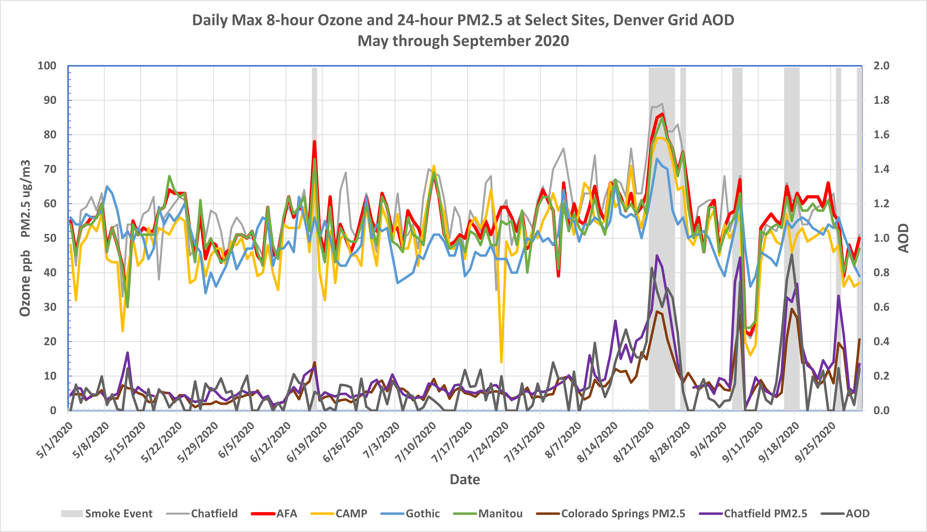
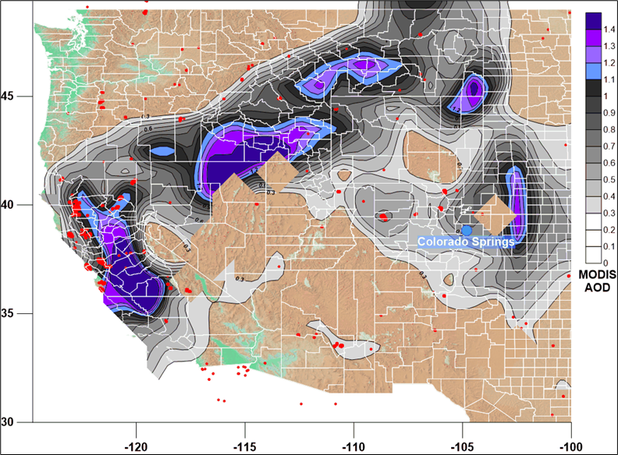
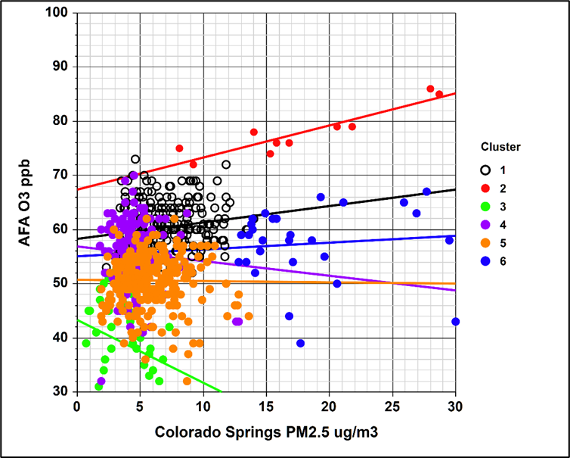
Screening and Weight-of- Evidence Methods for High-Ozone Events Associated with Wildfire Smoke
Presentation for the Western Regional Air Partnership (WRAP) Fire & Smoke Work Group
July 20, 2022
Patrick J. Reddy*
Scott Landes**
Air Pollution Control Division
Colorado Department of Public Health and Environment
*preddyresearch@gmail.com
**scott.landes@state.co.us

Slide 2
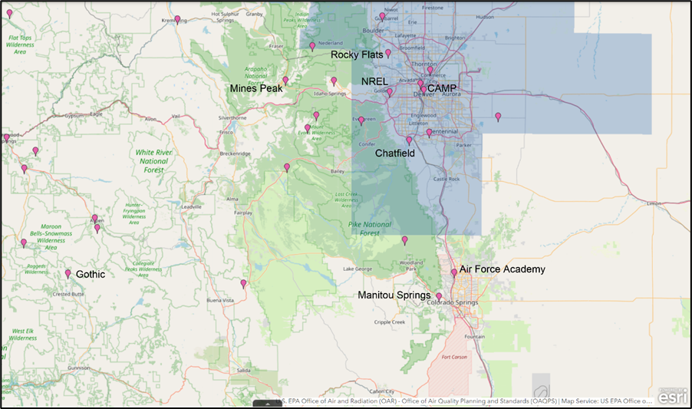
Some of the Colorado O3 sites considered in our analyses.

Slide 3
Data and Websites Useful for Screening Days for Smoke-Ozone Event Flags
(All sites allow access to archived data.)
AerosolWatch site: GOES and VIIRS visible imagery, satellite aerosol optical depth (AOD), fire detections, smoke masks, and TROPOMI satellite CO beginning in 2022: https://www.star.nesdis.noaa.gov/smcd/spb/aq/AerosolWatch/
NCAR ACOM Worldview: Visible satellite imagery; fires; a wealth of satellite measurements; TROPOMI satellite CO; AOD; modeled O3, PM2.5, and CO; and more: https://worldview.acom.ucar.edu/
AirNow Tech Navigator: Air quality data, HMS smoke coverage, trajectories, O3 wind roses, and meteorology: https://www.airnowtech.org/navigator/index.cfm#
InciWeb fire information: https://inciweb.nwcg.gov/
HYSPLIT forward and back trajectories: http://ready.arl.noaa.gov/HYSPLIT.php
Weather maps: ncei.noaa.gov/data/ncep-charts/access/ https://psl.noaa.gov/cgi-bin/data/narr/plotday.pl

Slide 4
Predictive Models and K-Means Cluster Analysis Can be Used for Both Event Screening and Weight-of-Evidence Analyses for an Exceptional Event Demonstration
Predictive models can include traditional multiple linear regression or Generalized Additive Models (GAMs). (see Gong et al., 2017, https://pubs.acs.org/doi/10.1021/acs.est.7b03130, and Flynn et al., 2021, https://doi.org/10.1525/elementa.2020.00104).
We have chosen multiple linear regression using Reddy and Pfister, 2016, as guidance for selecting variables (see https://agupubs.onlinelibrary.wiley.com/doi/full/10.1002/2015JD023840).
K-means cluster analyses can be based on daily max 8-hour O3, 24-hour PM2.5, satellite aerosol optical depth (AOD), daily meteorological variables, and daily predictive model residuals. The cluster analysis is an iterative process that involves testing the numbers of clusters needed to segregate normal high-O3 days and days likely to be affected by smoke.
MODIS AOD is available at: https://giovanni.gsfc.nasa.gov/giovanni/.
Daily NCEP Reanalysis meteorological variables are available at: https://psl.noaa.gov/data/timeseries/daily/.

Slide 5
A Cluster analysis based on May-September 2016-2021 data and using the following variables may be useful for refined screening, date selection for candidate exceptional events, and a weight of evidence analysis.
Air Force Academy O3
Manitou Springs O3
Chatfield O3
CAMP O3
RFLAT O3
NREL O3
FTCW O3
Greeley O3
Predictive model residuals for all 8 O3 sites
MODIS Aerosol Optical Depth (550_Dark_Target_Deep_Blue_Combined_Mean from: https://giovanni.gsfc.nasa.gov/giovanni/)
DEN 500 mb height (https://psl.noaa.gov/data/timeseries/daily/)
DEN 700 mb temperature(https://psl.noaa.gov/data/timeseries/daily/)
DEN 700 mb zonal wind speed(https://psl.noaa.gov/data/timeseries/daily/)
Daily max temperatures at Colorado Springs, Boulder, DIA, Fort Collins
The stats package used (NCSS) allows for cluster identification even when some fraction of the daily variables is missing on any given day. MODIS AOD, for example, is not always available.
Predictive models were based on daily max temperatures, 30-day averages of these, 500 mb heights, 700 mb temperatures, and 700 mb zonal winds.
Relevant meteorological variables will likely vary by region.

Slide 6
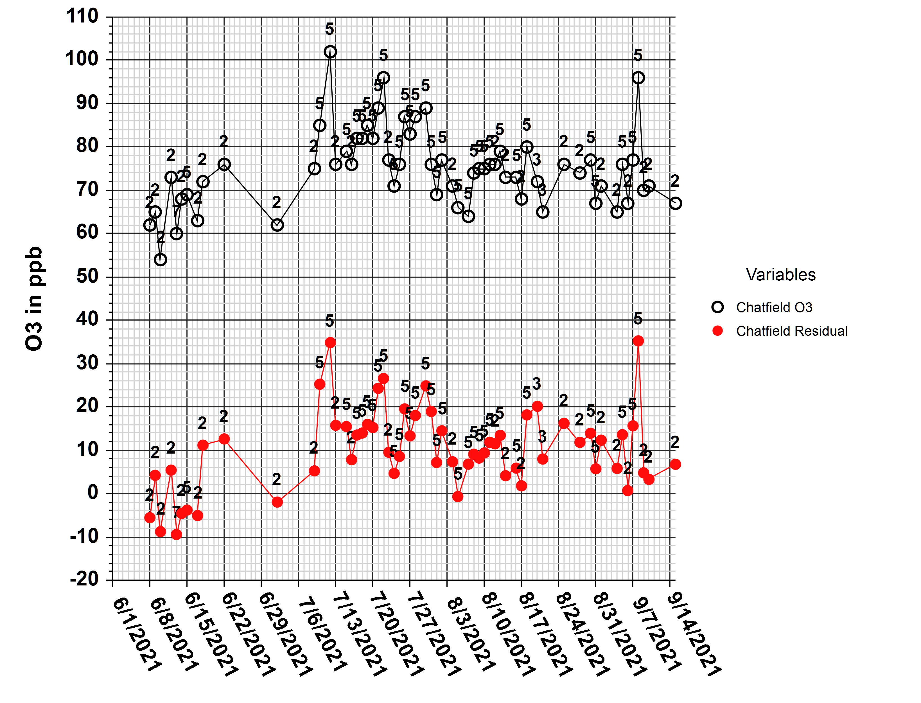
There may not be sufficient evidence for exceptional event status for every day flagged by analysts. Cluster analysis paired with model residuals can help to identify candidate exceptional event days.
These are Front Range days in 2021 flagged for smoke without the aid of cluster analyses, along with Chatfield daily max 8-hour O3 and predictive model residuals.
Data points are labeled by cluster number. Cluster 2 represents normal high-photochemistry days, and cluster 5 represents likely smoke-ozone events.
In this case, all concentrations > 76 ppb belong to cluster 5. An exceptional event analysis for high-O3 cluster 5 events might be more definitive than analyses for other flagged events.

Slide 7
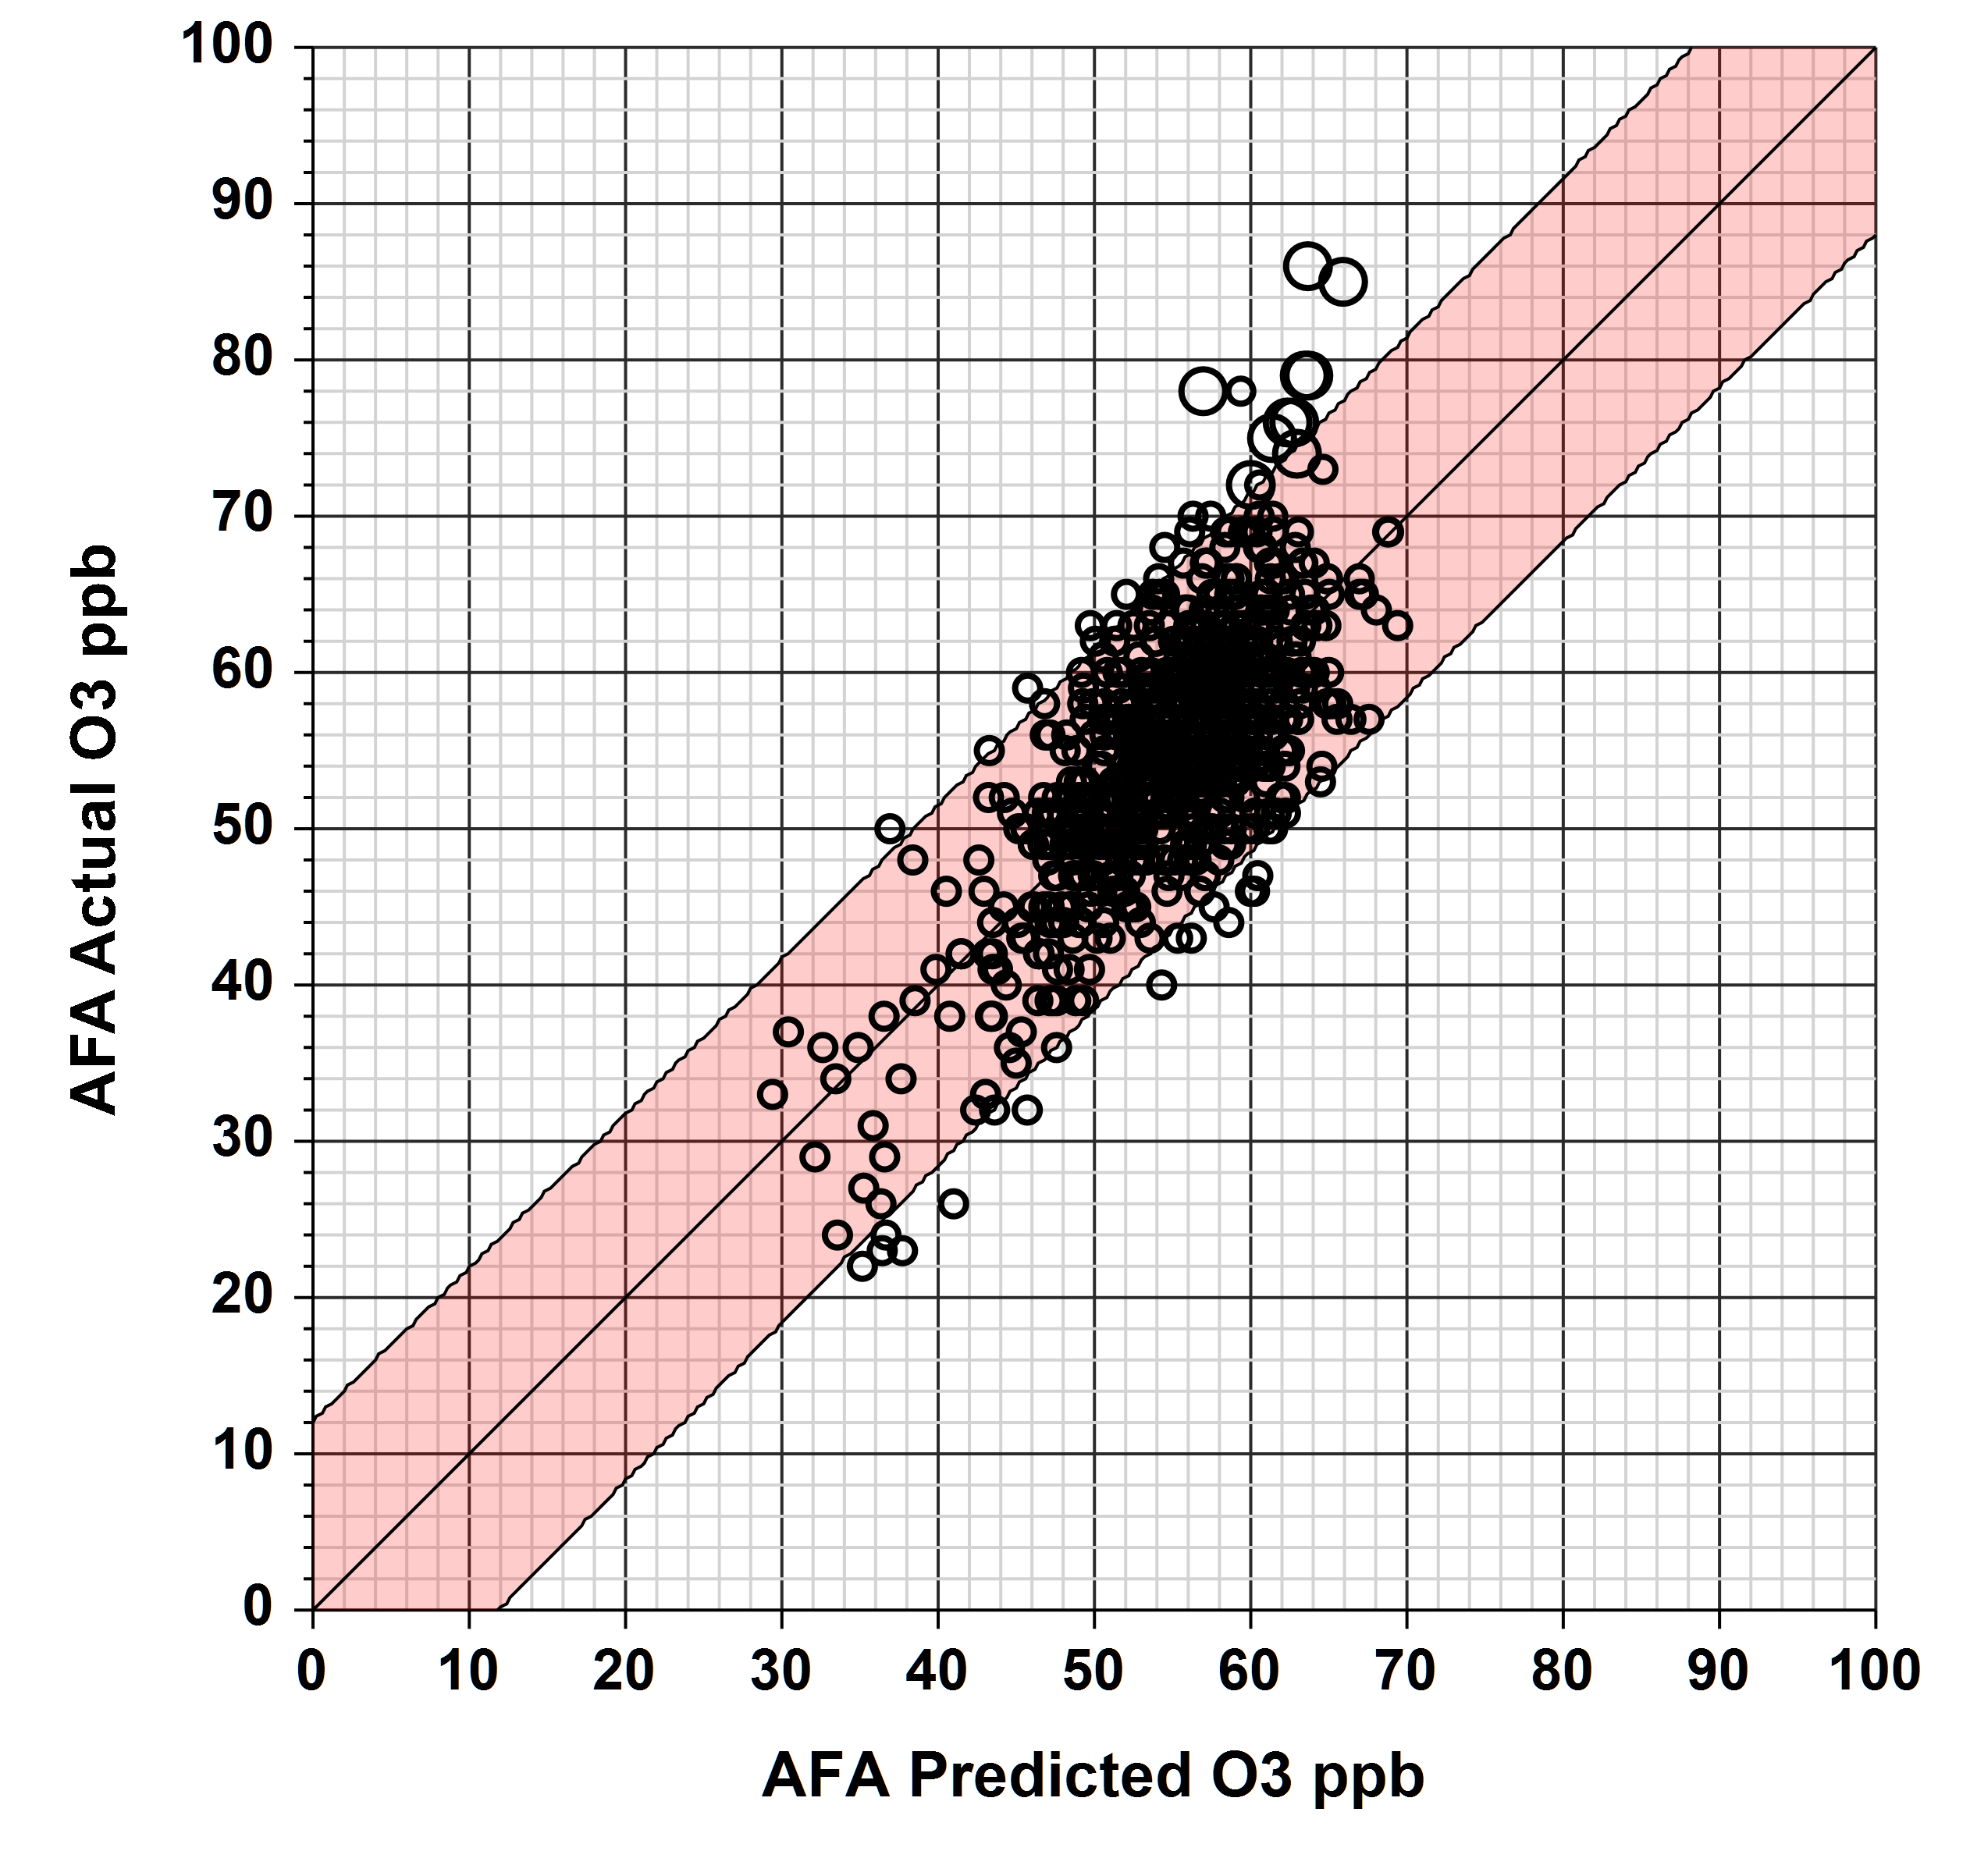
Predictive Model Example: Air Force Academy (AFA)
We developed May-September (2016-2020) predictive regression models for AFA and Manitou Springs based on meteorological variables and 30-day O3 concentrations
(r-square of 0.53 and 0.56, respectively).
Variables:
Colorado Springs daily max temperature and 30-day average max temperatures.
30-day average O3, this captures O3 seasonality – not recommended for 2021.
Daily mean Four Corners 500 mb heights.
Daily MODIS cloud fraction.
Front Range 700 mb daily mean temperature.
Flagged smoke events (large circles) clearly fall outside the normal range.

Slide 8
Time Series For Colorado Springs Area for May-September 2020

Slide 9
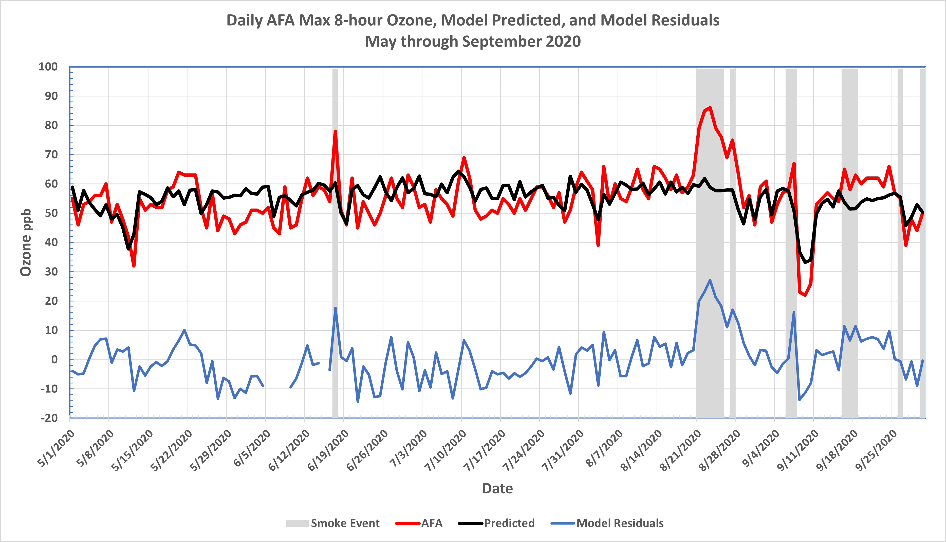
Only smoke days have AFA residuals greater than 10 ppb.

Slide 10
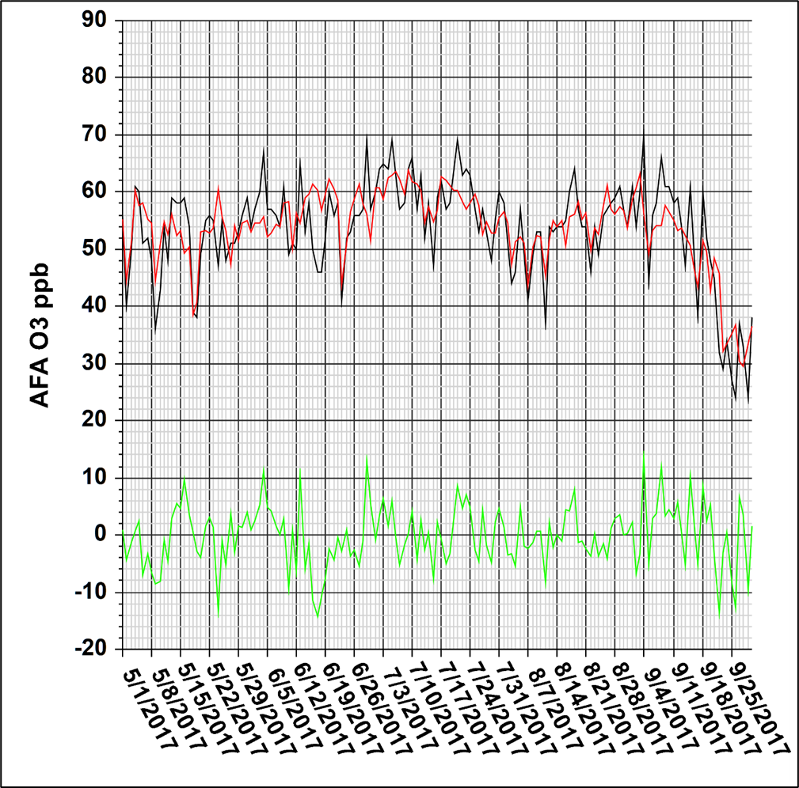
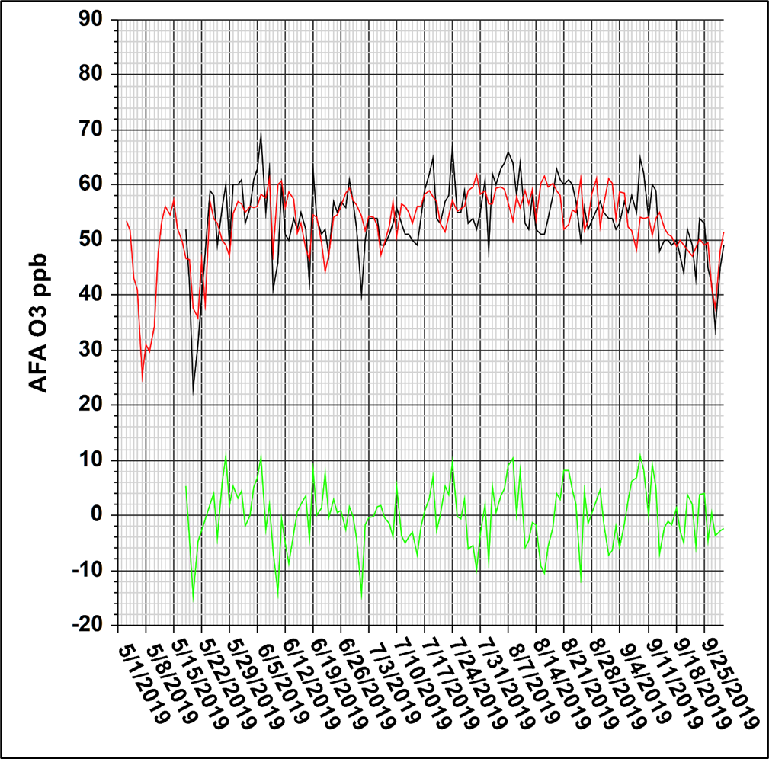
AFA daily 8-hour max ozone (black), regression predicted (red), regression residuals (green) – 2017 left and 2019 right.

Slide 11
Cluster Analysis for Colorado Springs Area Sites 2016-2020
Cluster analysis of 8 meteorological and air quality variables and CDPHE smoke event flags for May-September 2016-2020.
Cluster 1 represents normal high-O3 weather conditions. Cluster 2 represents nearly identical conditions, but all 10 members were flagged and PM2.5 was high. Mean O3 differences ~ 18 ppb.
Cluster 6 represents cooler, windier conditions and includes September 2020 smoke events.
Comparison of clusters 1 and 2 takes the place of comparing event days with a limited number of similar days, and it is a more robust way to look at the differences.

Slide 12
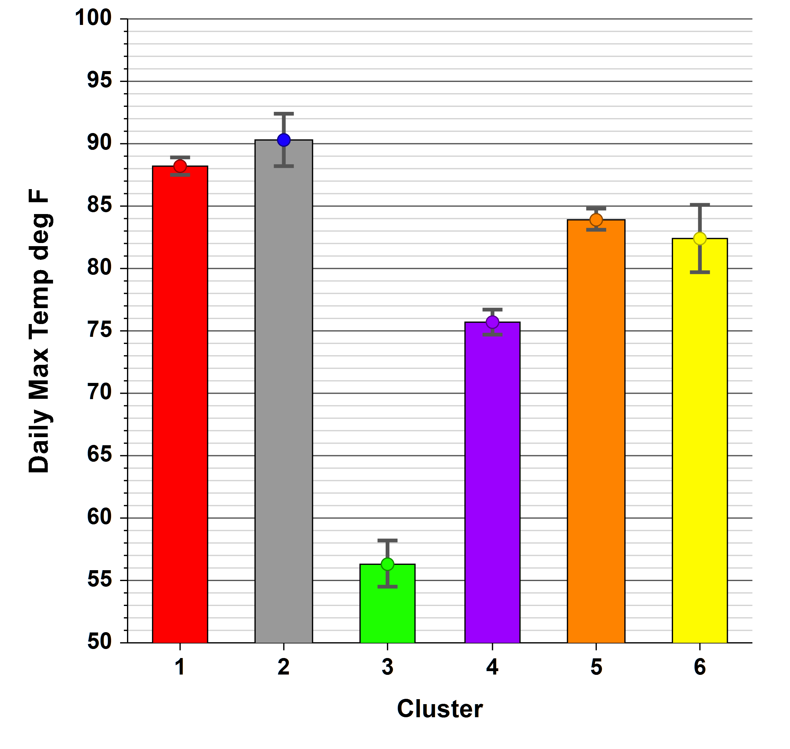
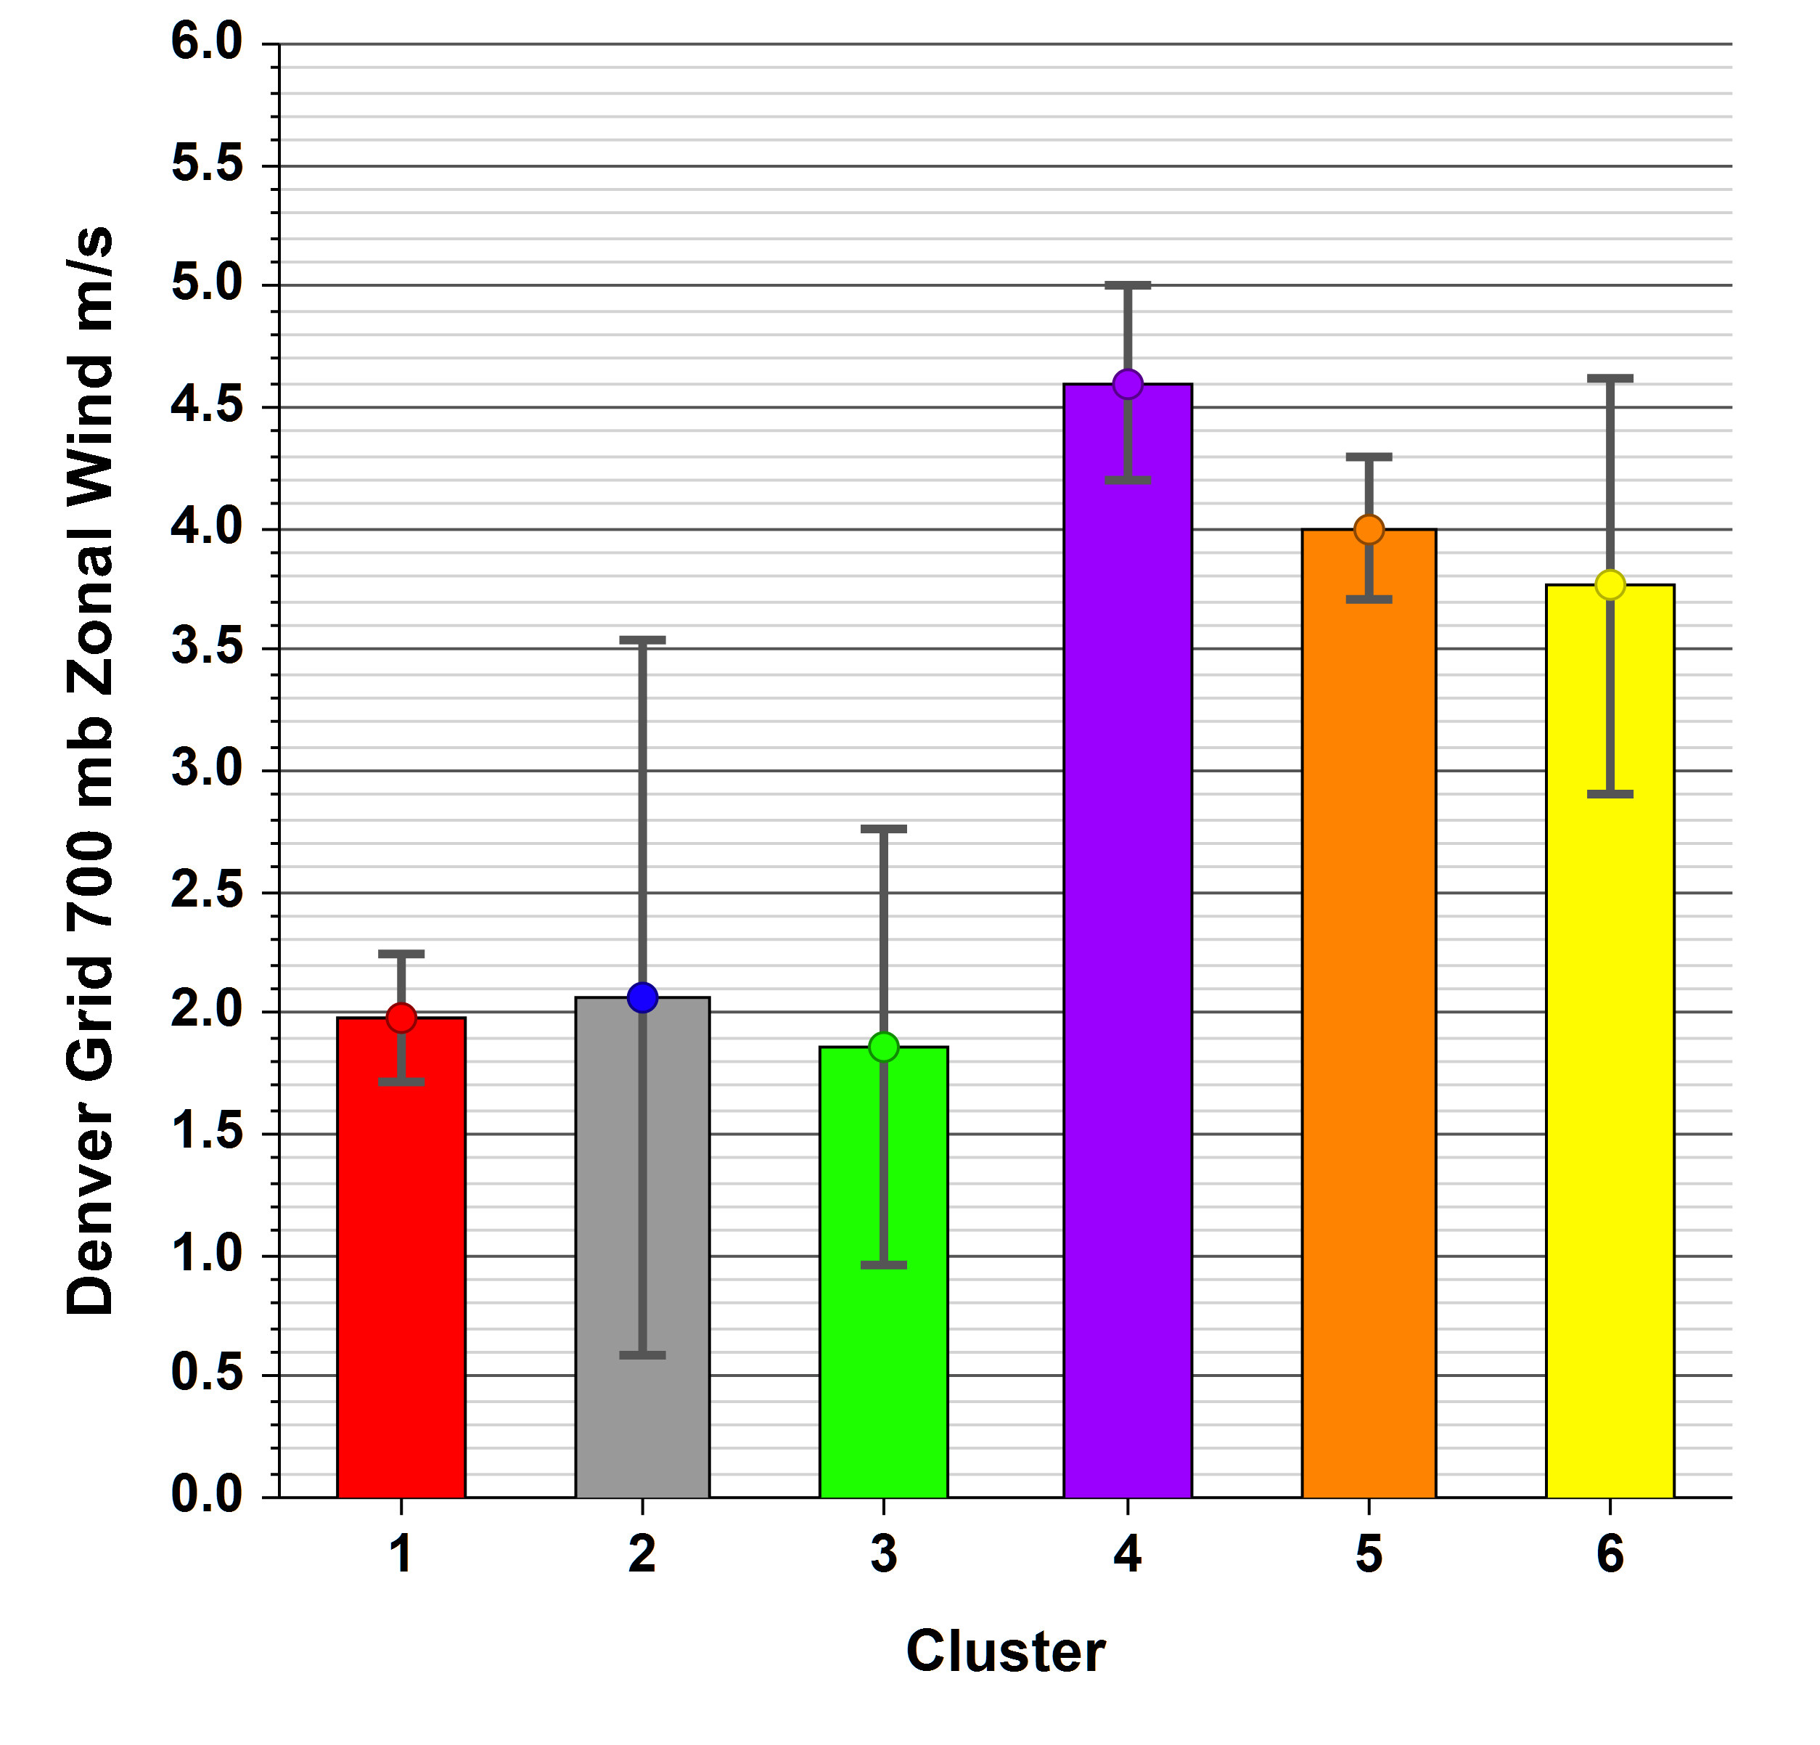
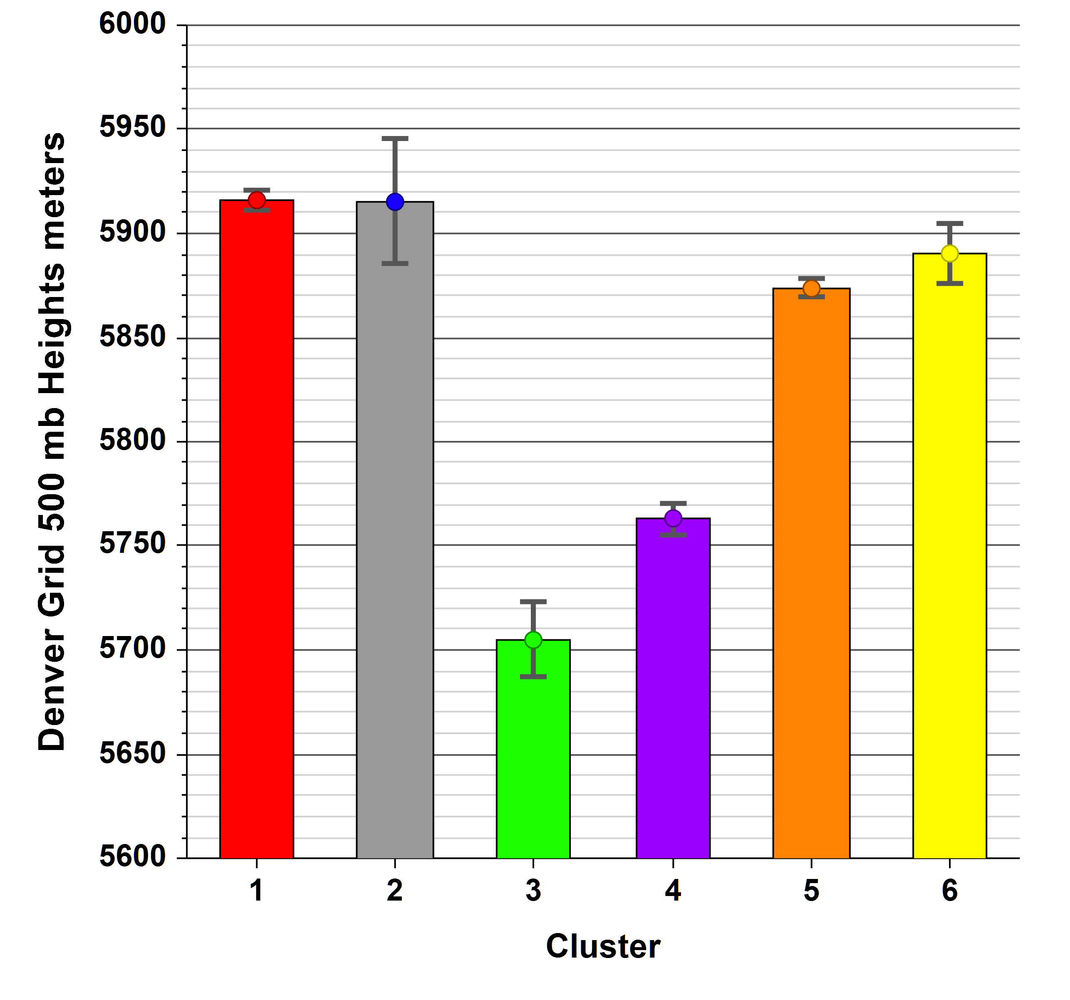
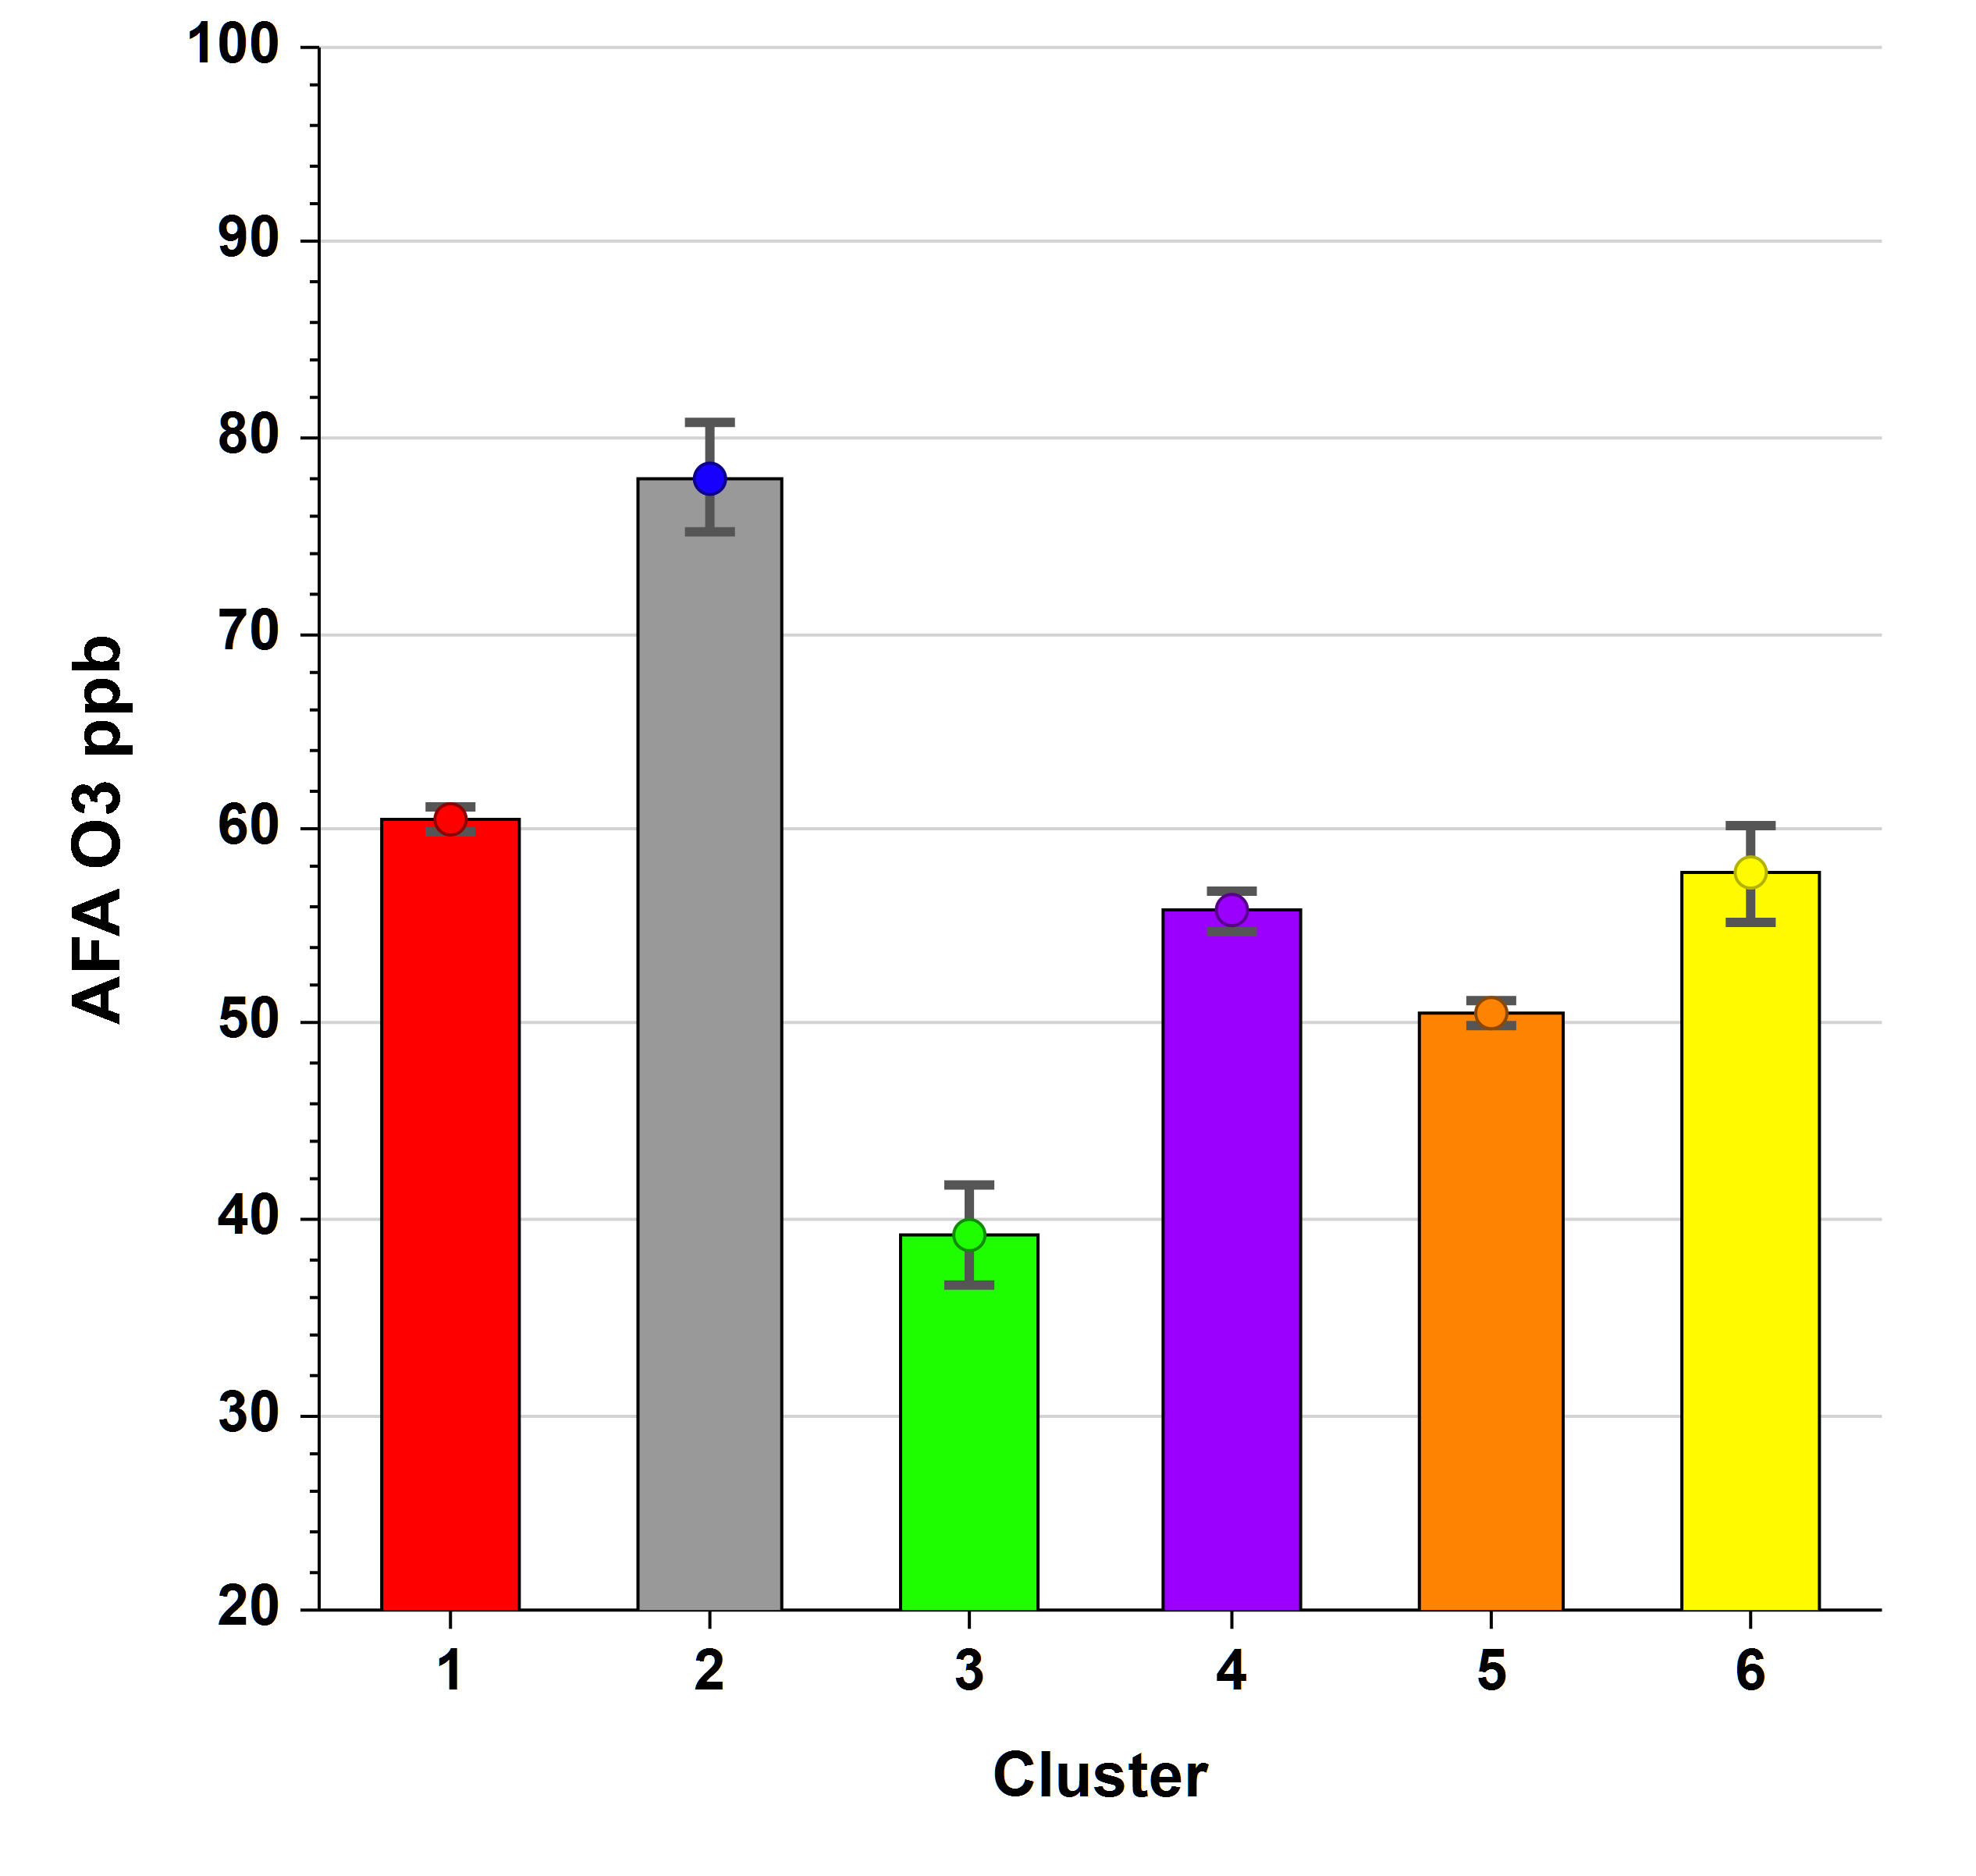
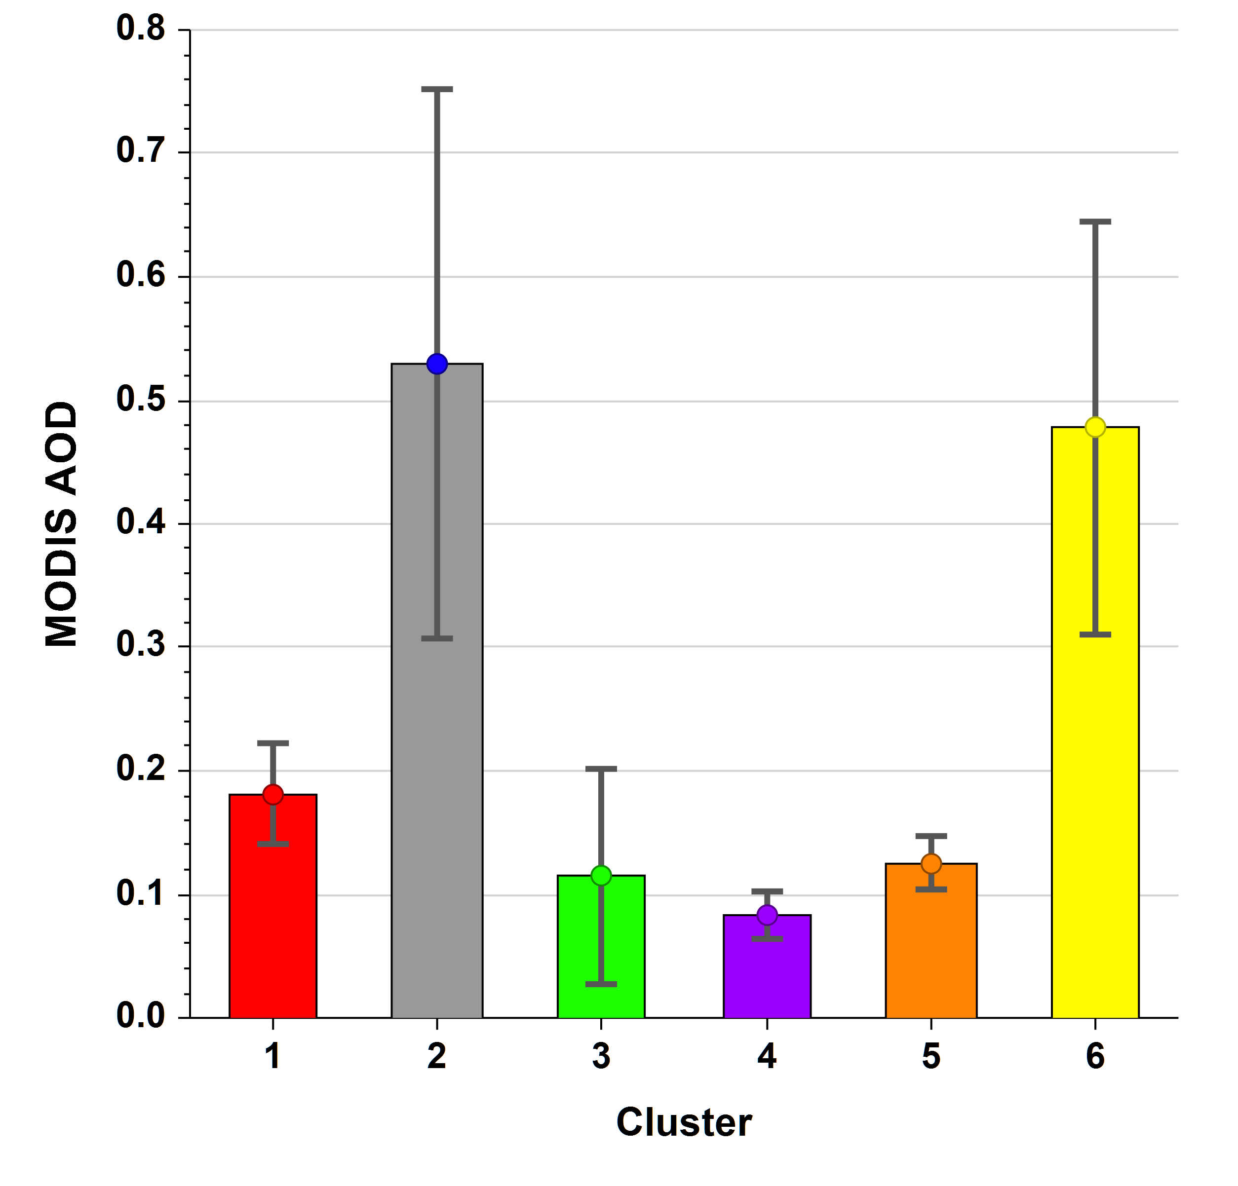
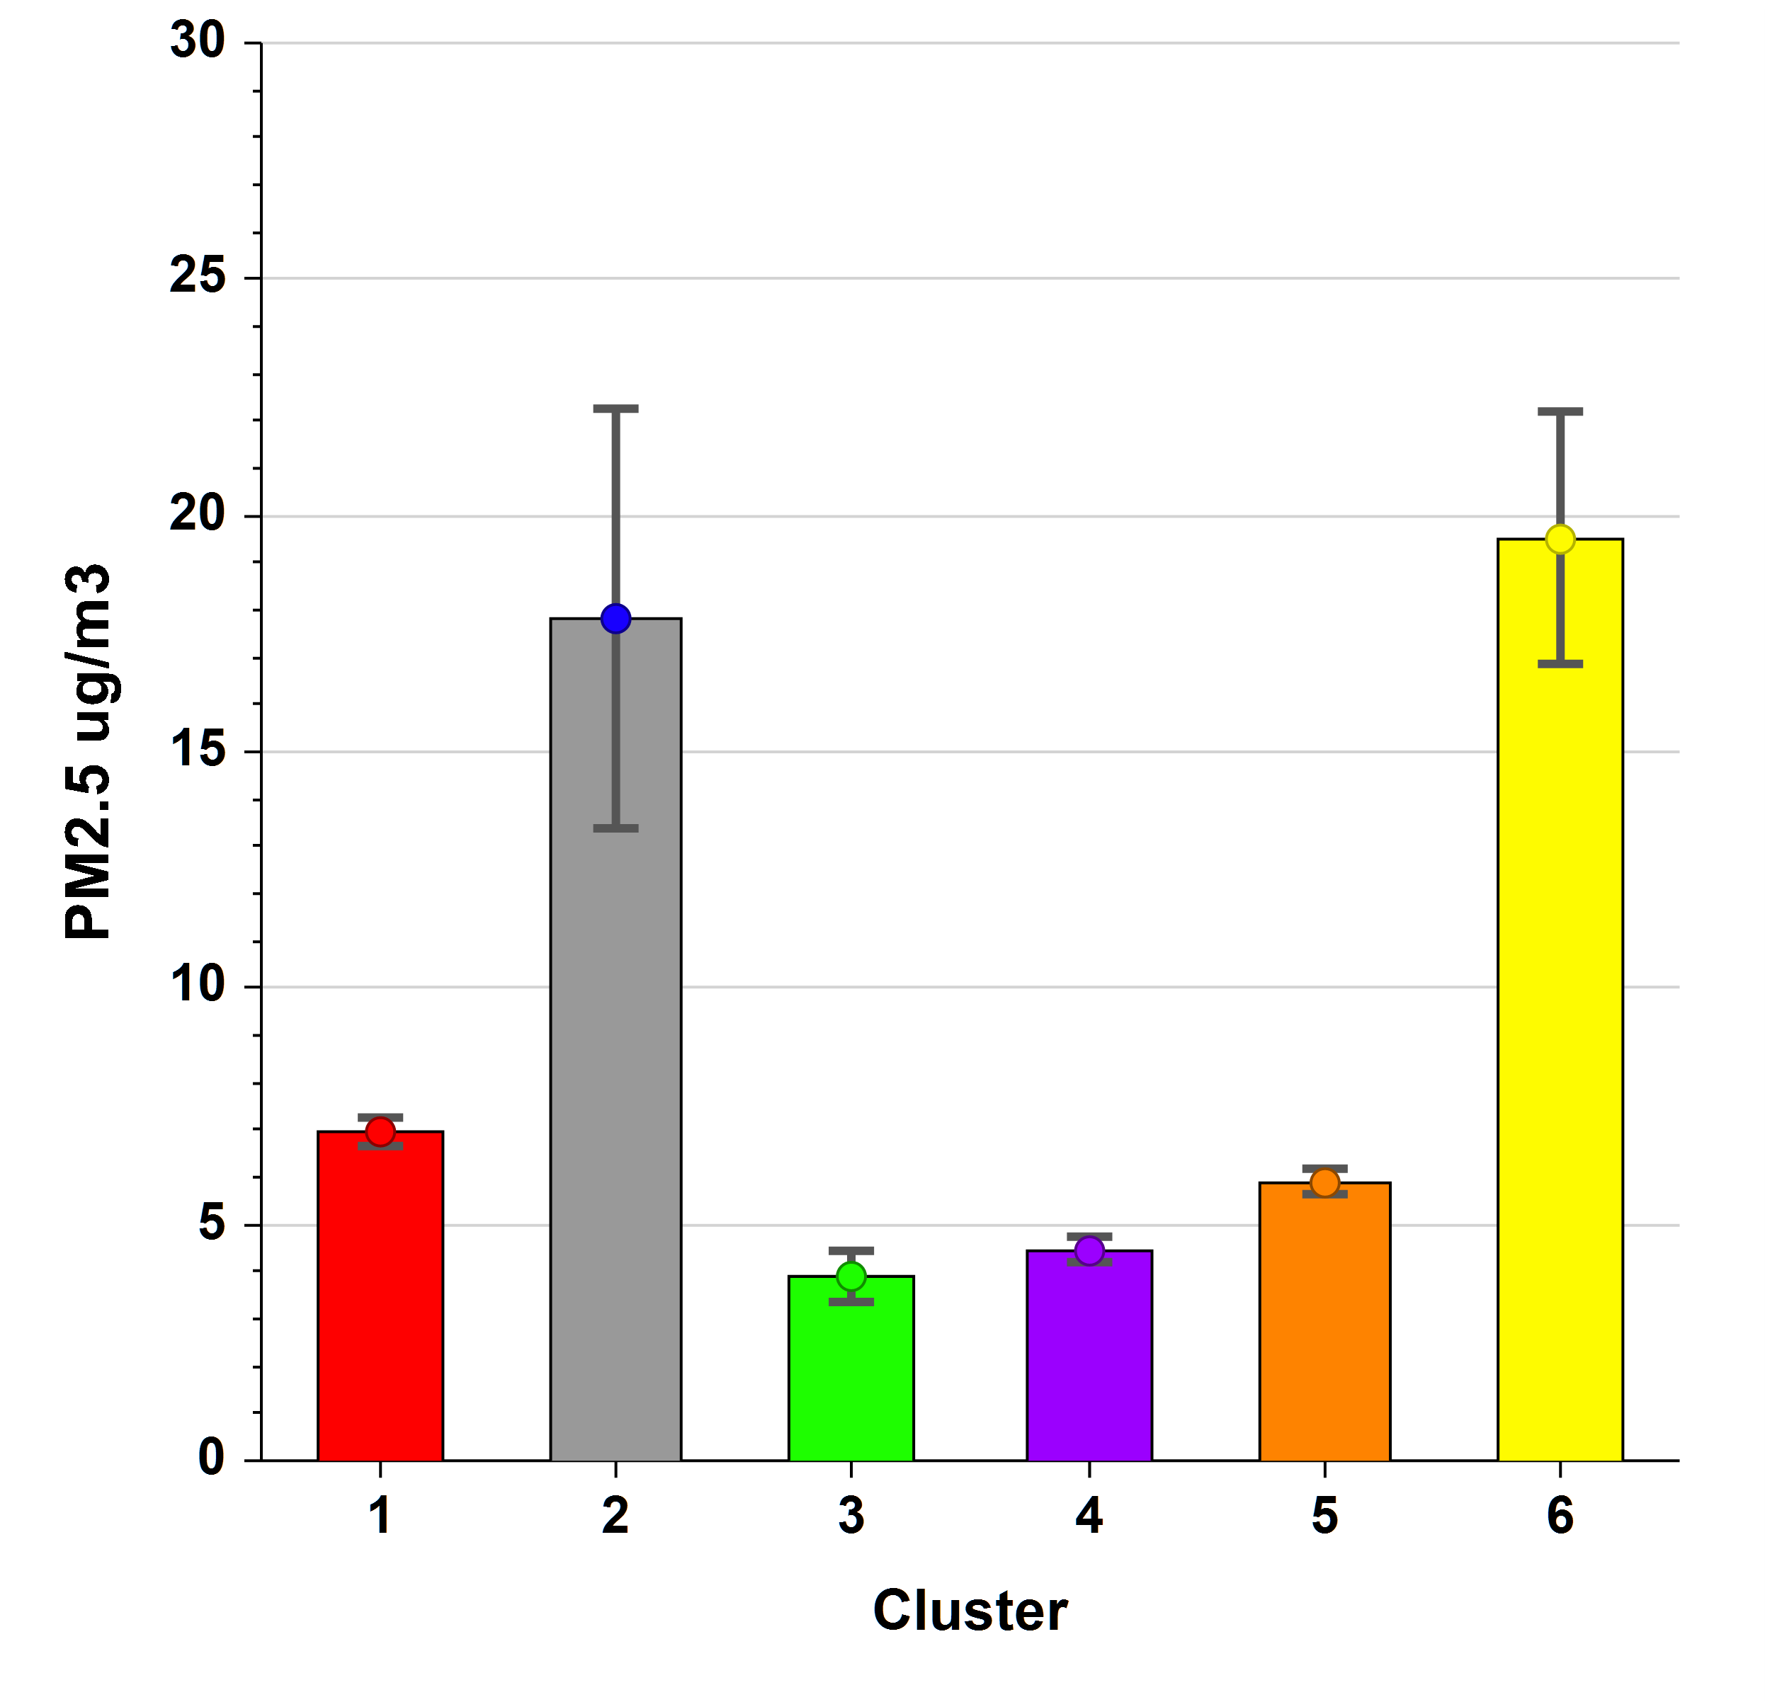
Cluster Comparisons

Slide 13
AFA daily max 8-hour ozone versus PM2.5 by cluster with linear regressions for May-September 2016-2020. Smoke events are categorized as cluster 2. R-squared for regression between O3 and PM2.5 for cluster 2 days = 0.84.

Slide 14
Conservative Estimates of Smoke Contributions Based on Subtraction of the 95th Percentiles for Positive Model Residuals from the Day-Specific Predictive Model Residuals (EPA Method)

Slide 15
Estimated Smoke Contributions Derived by Subtraction of Mean Model Residuals for Normal High-O3 Cluster Days from Model Residuals on Exceptional Event Days
(All event day concentrations were at or above the 99th percentile values for typical high-concentration days - Cluster 1.)

Slide 16
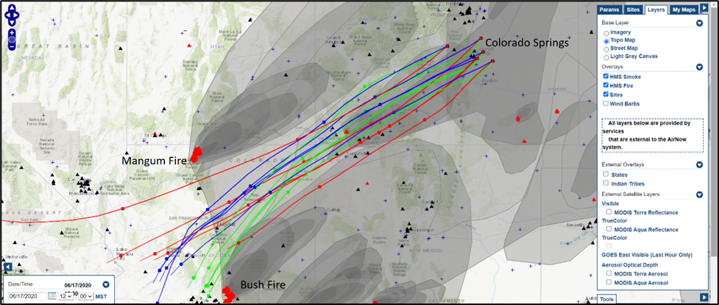
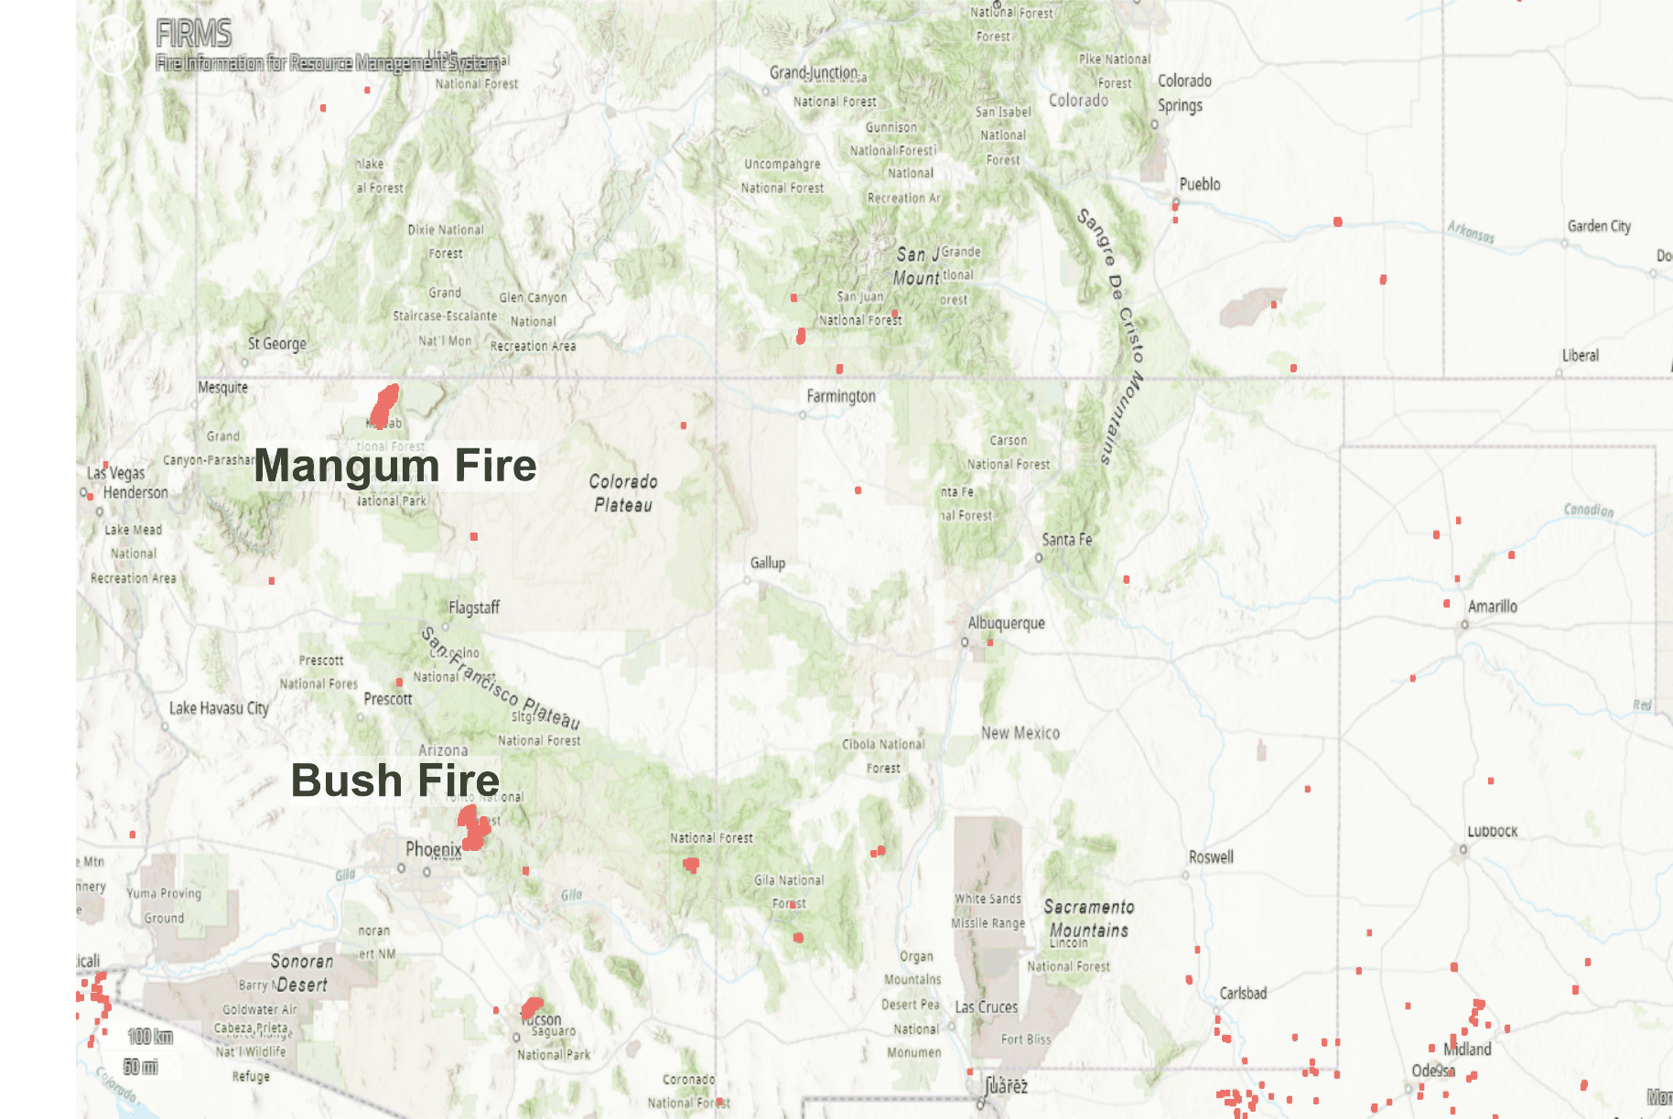
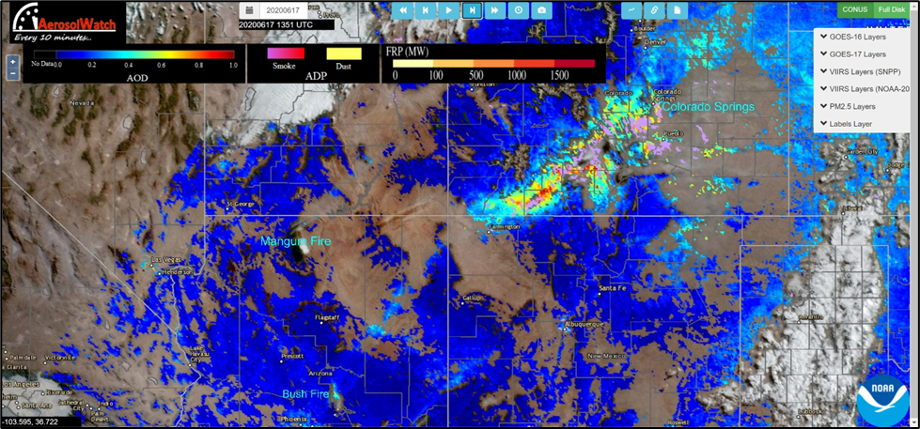
The Mangum and Bush Fires in AZ likely contributed to June 17, 2020, exceedances at AFA and MAN. Back trajectories (right) support transport of smoke.
GOES 16 aerosol optical depth (AOD) and smoke mask in pink (lower right) confirm presence of smoke
(https://www.star.nesdis.noaa.gov/smcd/spb/aq/AerosolWatch/ ).

Slide 17
Analysis of MODIS Aerosol Optical Depth (AOD), HMS Fires, Wind Streamlines, Forward Trajectories, HRRR Near-Surface Smoke, and TROPOMI CO for August 21-25, 2020
HYSPLIT forward trajectories computed for a source matrix that covers the region of California with the largest fires during the period.
Experimentation with HYSPLIT showed that trajectories at 3000 AGL meters were probably most representative of long-range transport.
California fires on August 18-20 seem to have the greatest influence on August 21-25 air quality in Colorado Springs. Local recirculation and residual smoke sustained smoke later in the period.
From August 21-23, the active transport of smoke shifted well north of Colorado, and there is no evidence that significant quantities of new smoke arrived from California after August 20.
Q/D estimates for California fires should be based on August 18-20 emissions, but we opted for a Tier 3 analysis for the six 2020 smoke events in Colorado Springs instead.
A draft demonstration document has been completed for these six days. Regression models, K-means cluster analysis, percentile analyses, estimated smoke impacts, and a storyboard analysis of the broad impacts of smoke form the basis of the demonstration.

Slide 18
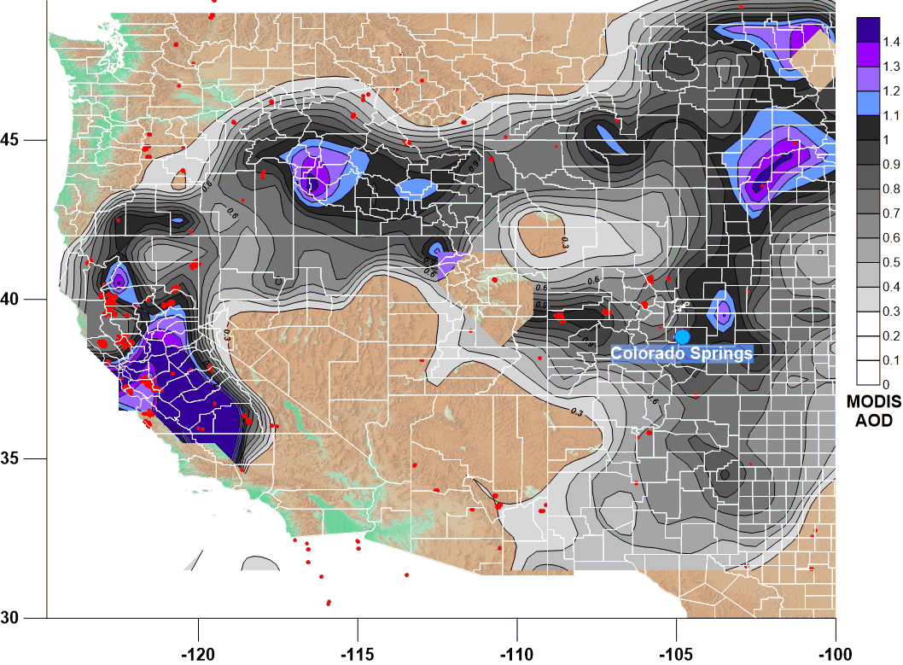
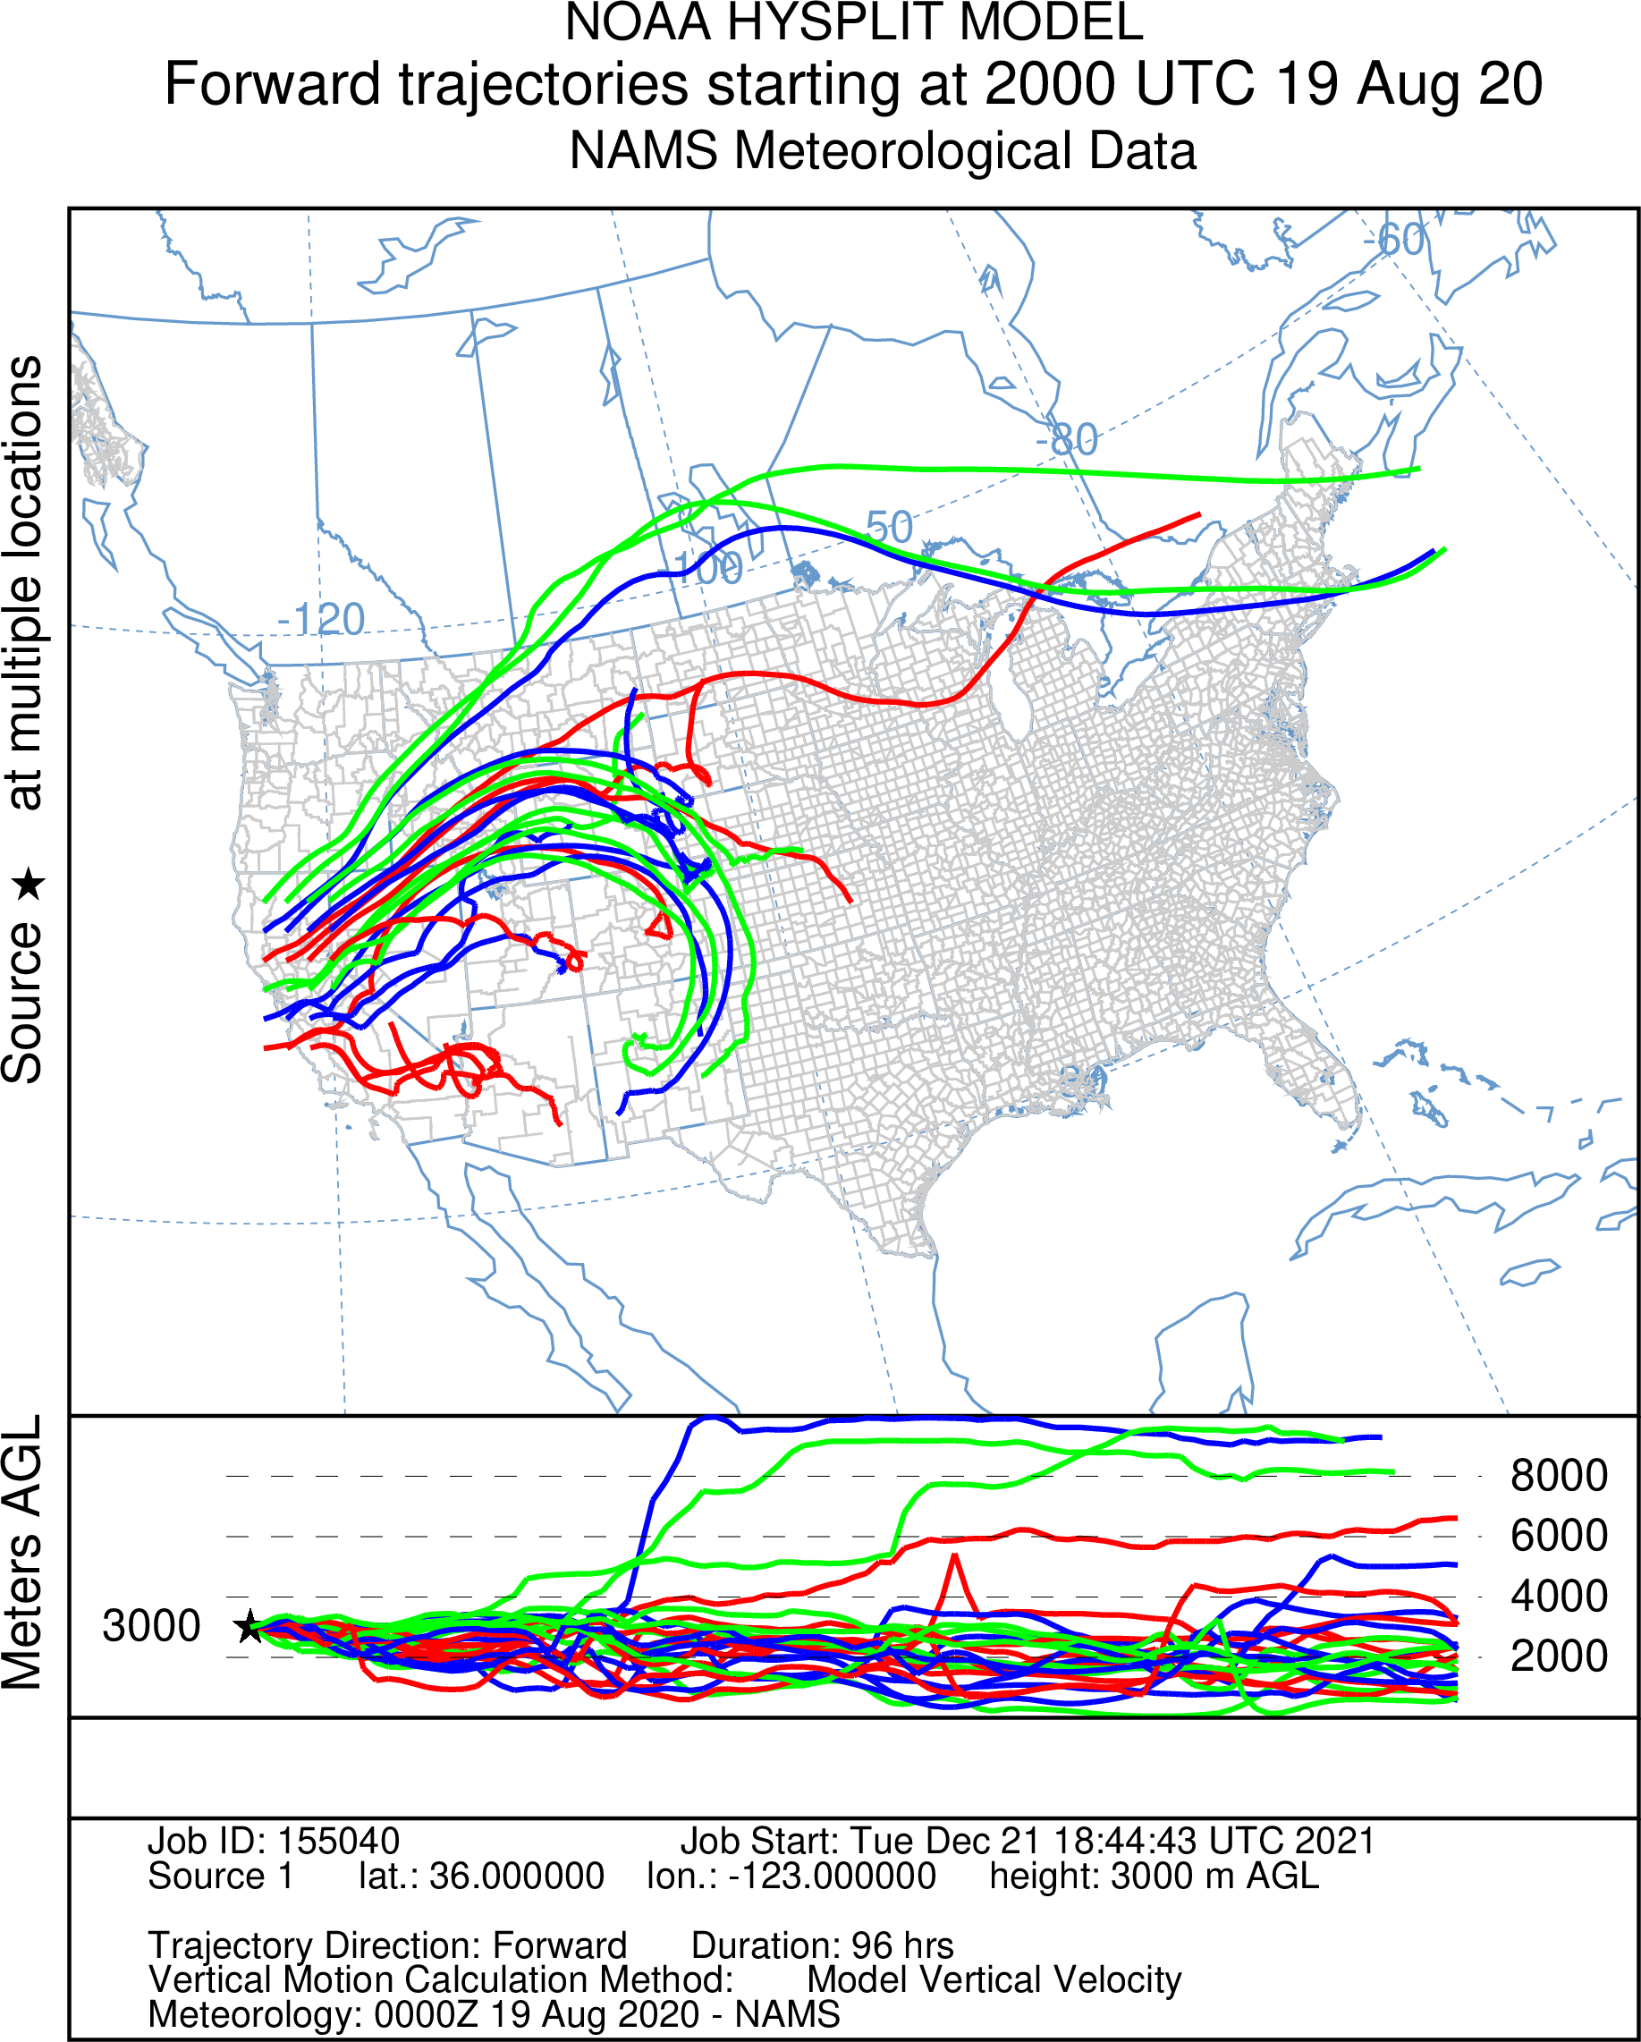
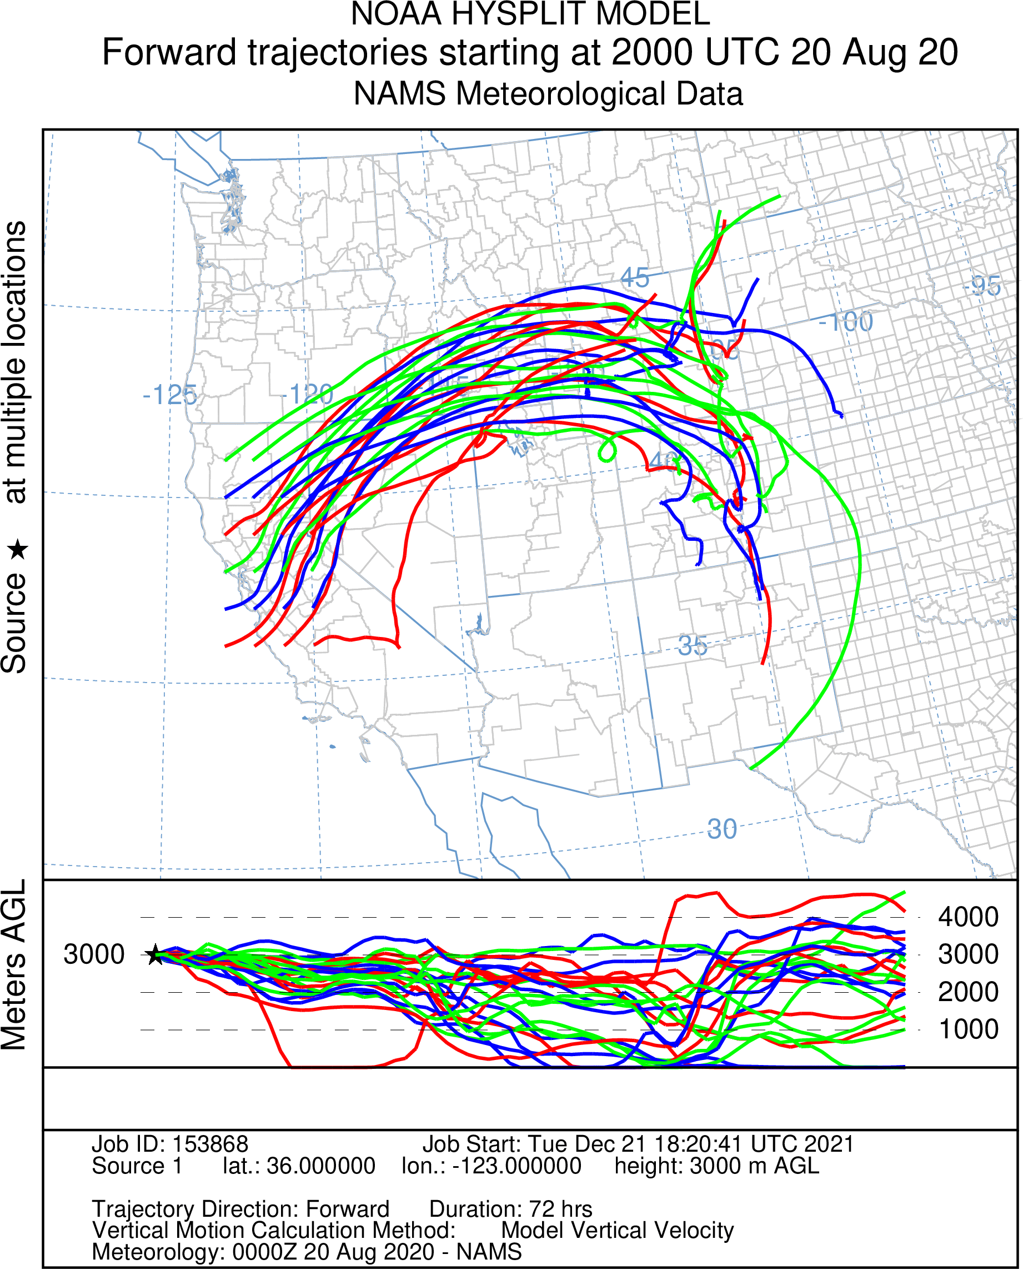
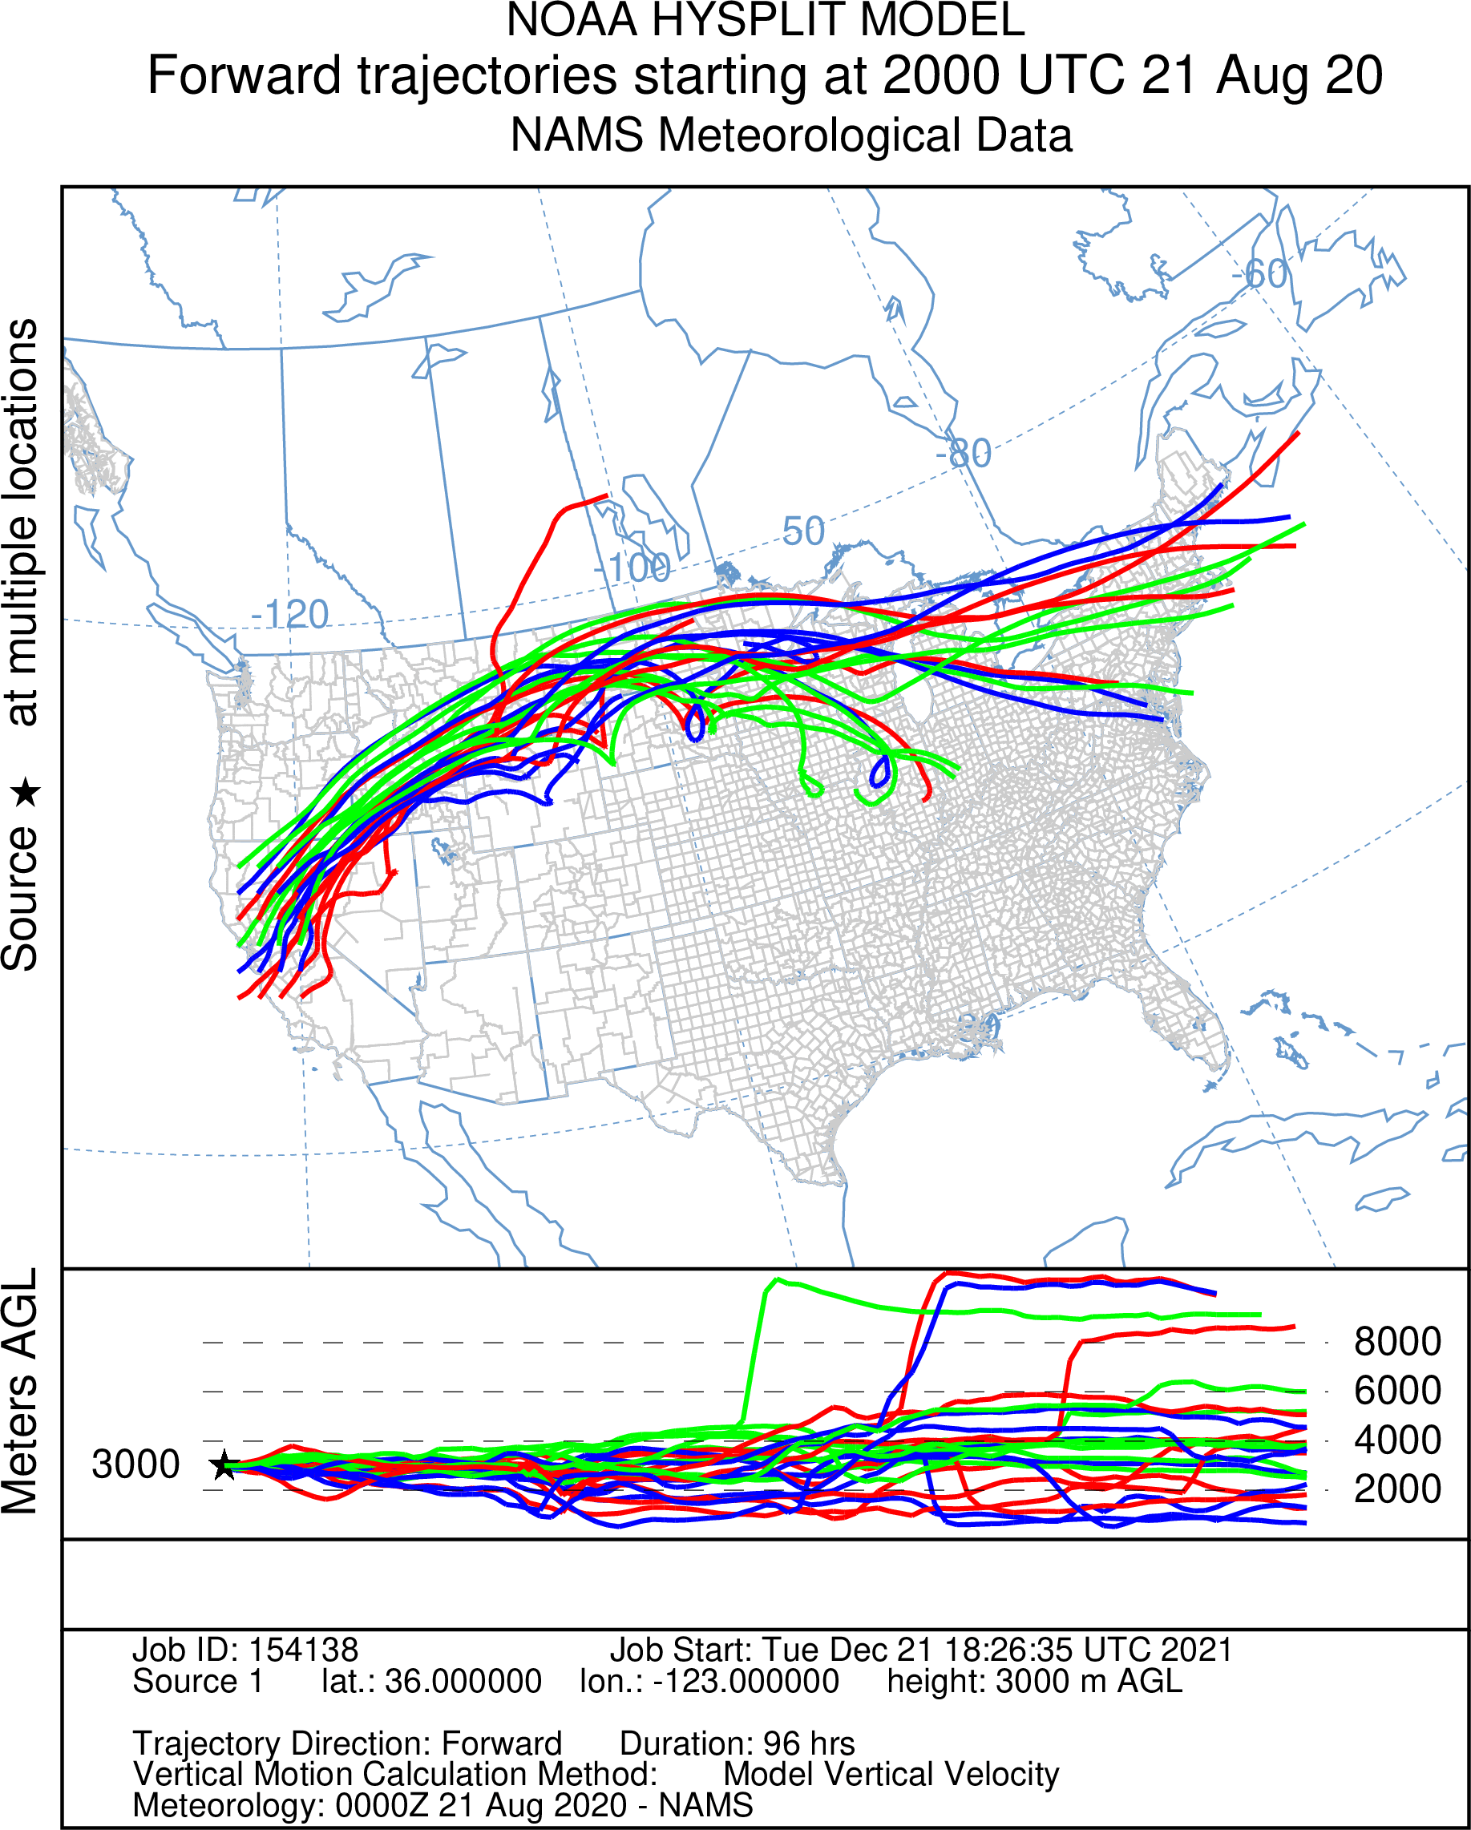
Forward trajectories at 3000 meters from a matrix of N CA sites.
August 21 does not
directly contribute to
any day during the Aug 21-25 event.
August 23, 2020
MODIS AOD above 0.3 as an objective measure of smoke density, contributions in Colorado from CA fires on August
19 and 20.

Slide 19
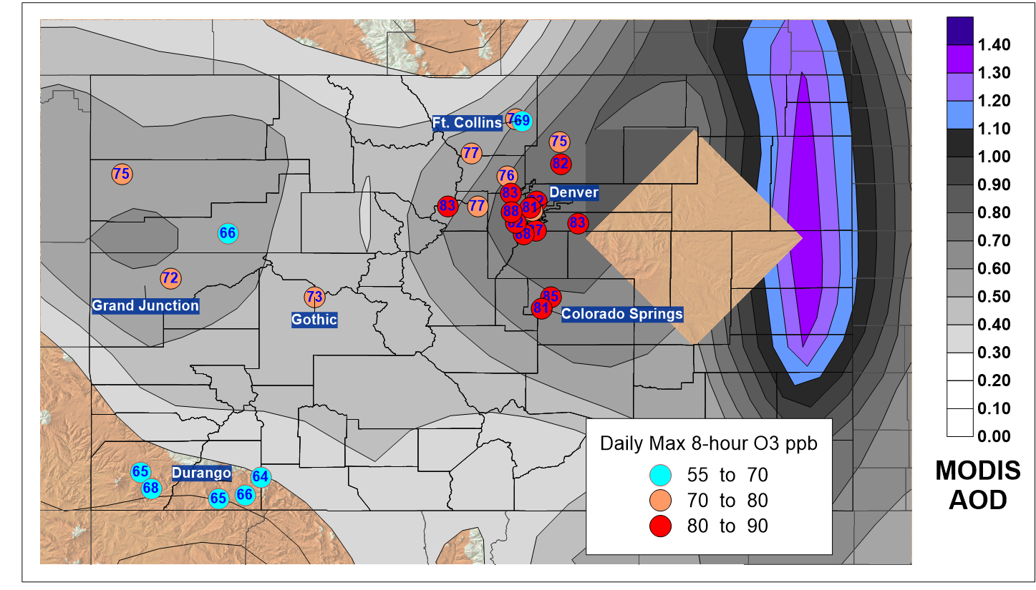
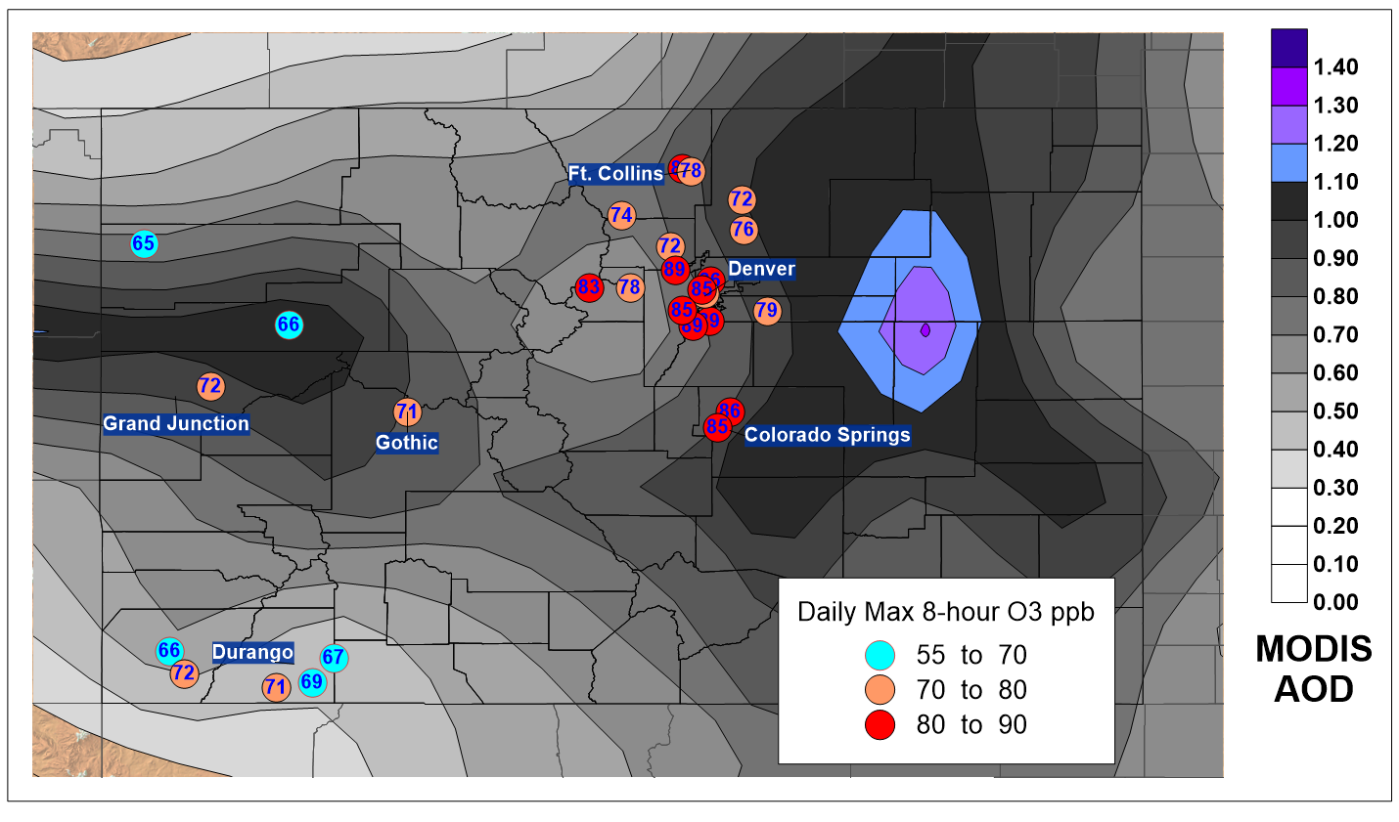
Mapping Daily Max 8-hour O3 and MODIS AOD Provides Evidence of Smoke Impacts on O3
August 22, 2020 August 23, 2020

Slide 20
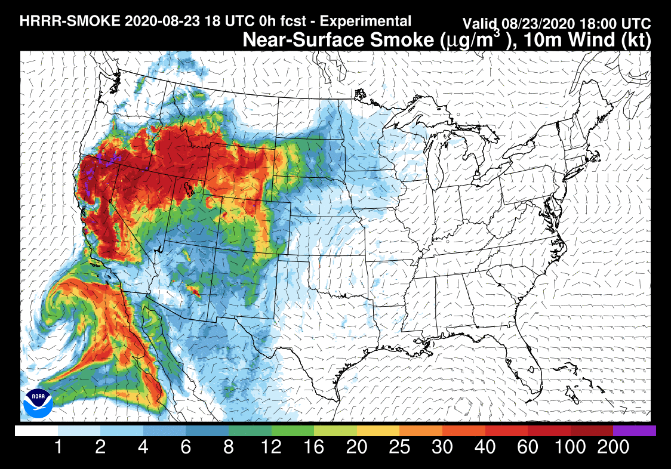
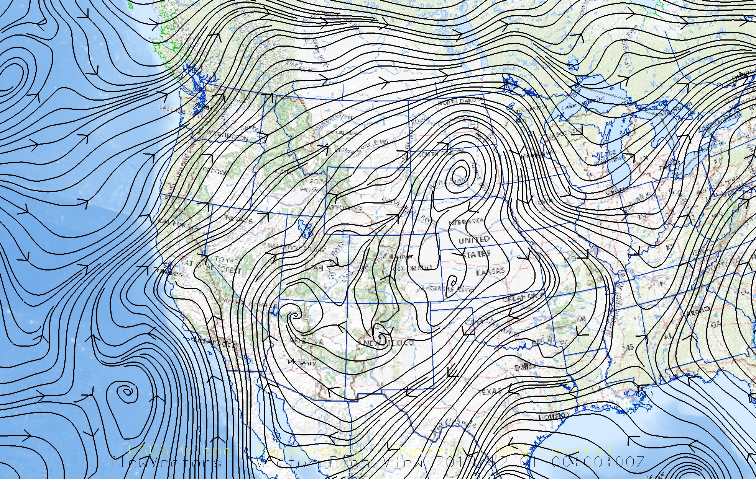
Mean NARR 700 mb (~3000 meters) wind streamlines for August 23, 2020, showing active transport well north of Colorado. (https://psl.noaa.gov/cgi-bin/data/narr/plotday.pl)
HRRR model near-surface smoke PM2.5 concentrations provide evidence that transport and mixing would have brought residual smoke to the surface. https://rapidrefresh.noaa.gov/hrrr/HRRRsmokeold/

Slide 21
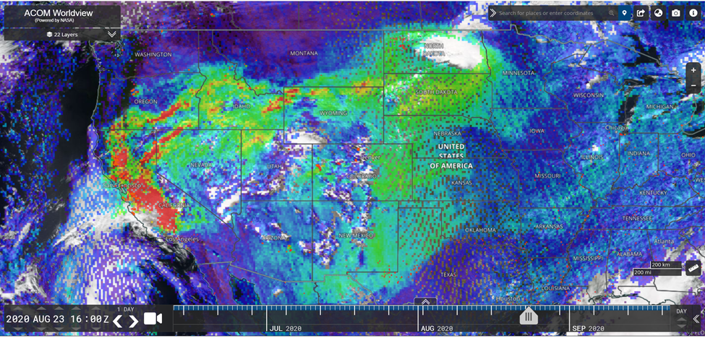
August 23 TROPOMI satellite CO from NASA – NCAR ACOM Worldview site.
MODIS AOD > 0.3 and TROPOMI CO footprints matched almost perfectly on every day from August 18-25, 2021.

